Slide 1
Quantum Mechanics
History, Concepts and Experimental Verification
R. Steven Millward
ISU QuarkNet Seminar
June 24th, 2024

Slide 2
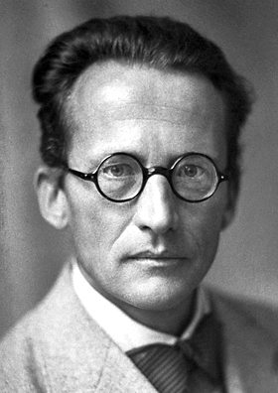
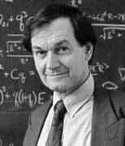
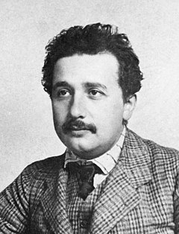
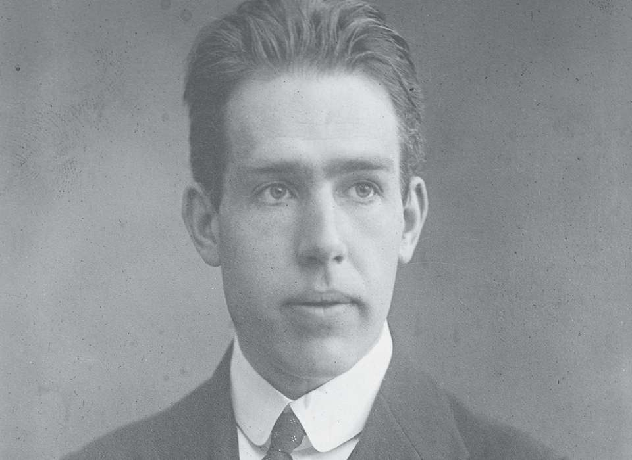
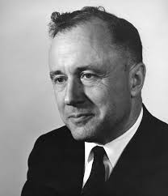
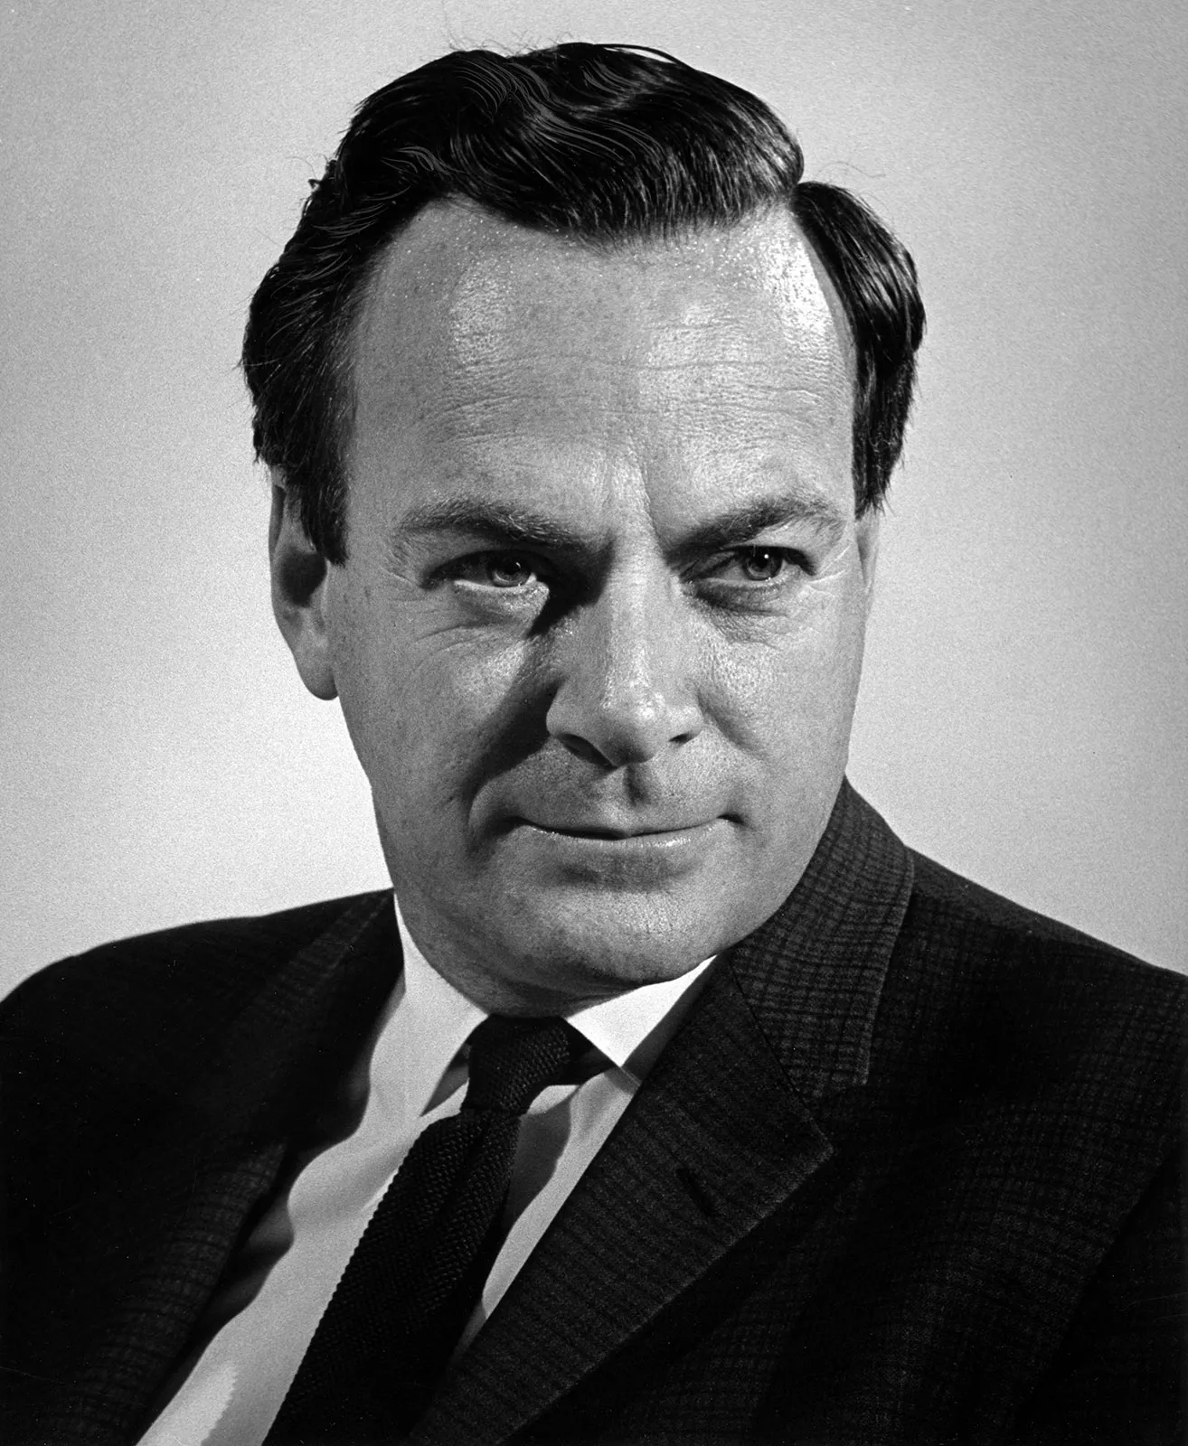
Disclaimer
Dante is correct when it comes to understanding quantum mechanics.
If you don’t believe me, listen to the giants of the field.
“Those who are not shocked when they first come across quantum theory cannot possibly have understood it” Niels Bohr
“If you are not completely confused by quantum mechanics, you do not understand it.” John Wheeler
“It is safe to say that nobody understands quantum mechanics.” Richard Feynman
“Quantum mechanics makes absolutely no sense.” Sir Roger Penrose
Even those who helped create it weren’t really thrilled with it.
“I do not like quantum mechanics, and I am sorry I ever had anything to do with it.” Erwin Schr$\ddot{o}$dinger
“If quantum theory is correct, it signifies the end of physics as a science.” Albert Einstein
Thus, don’t go into this thinking you will understand this lecture…you probably won’t.

Slide 3
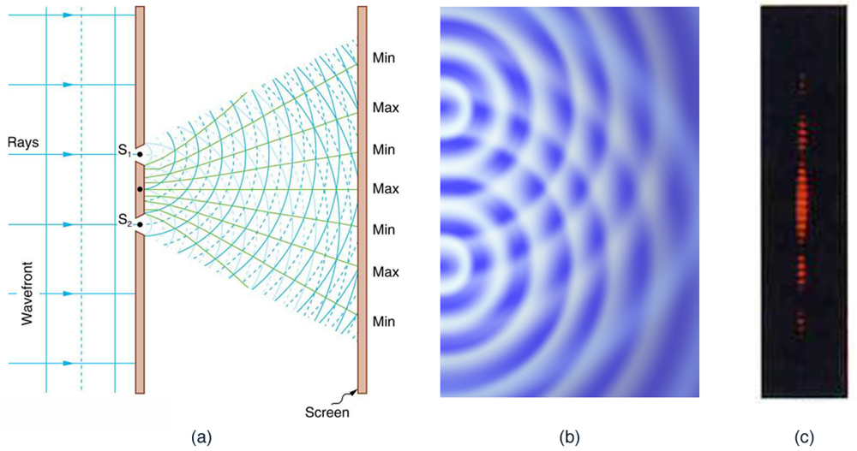
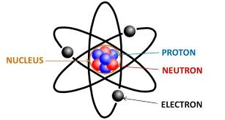
Particles and Waves
Much of the physics of the early 20th century could be explained using two basic concepts.
Particles seemed to have no internal structure but a definite position and momentum.
Examples include protons, neutrons and electrons.
Waves could not be defined to be at a certain location, but were spread out in space with a wavelength and frequency associated with them.
Examples include waves on a string, sound waves and light.
The fact that light was a wave was very well established by Young’s double slit experiment, showing light exhibiting both diffraction and interference.
Questions such as “Where is the wave?” or “What is the frequency of the particle?” were nonsensical and the distinction between particle and wave was clear.

Slide 4
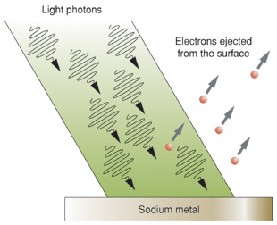
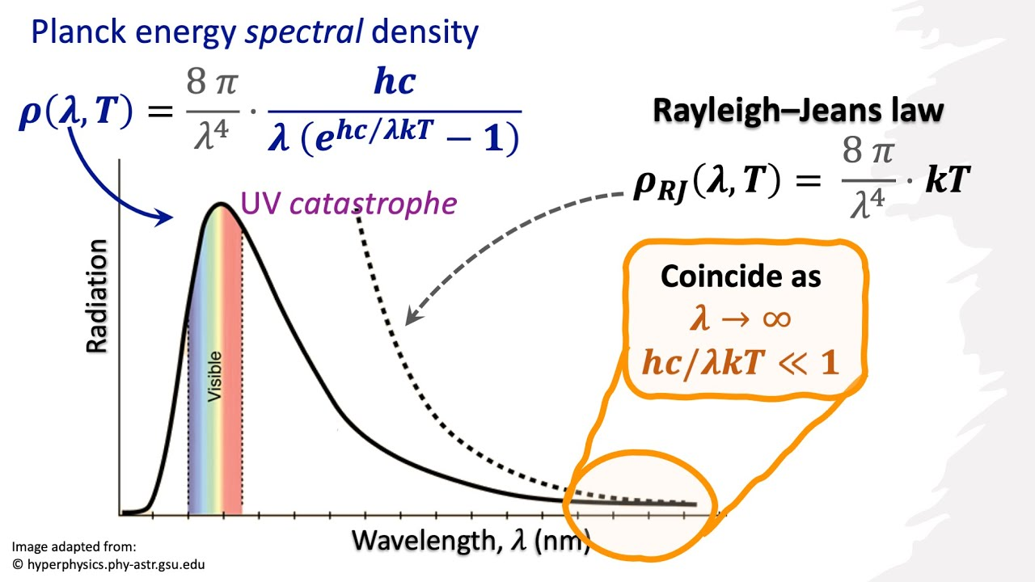
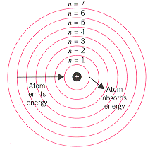
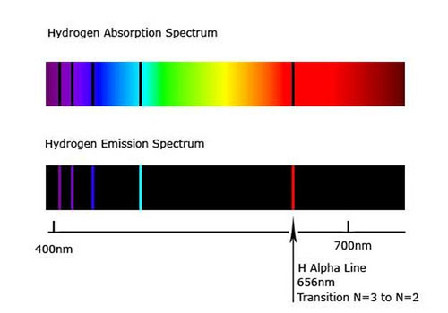
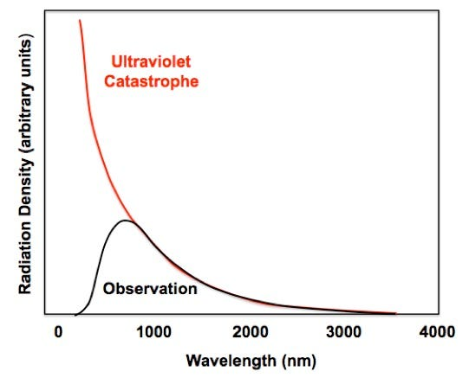
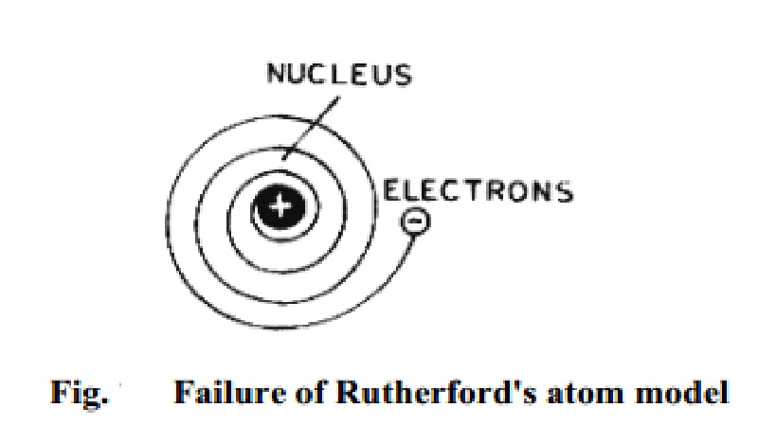
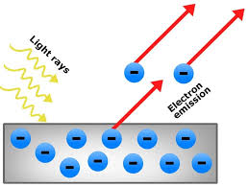
Early 20th century problems
By the 1920’s, several issues were known that could not be properly explained with current physical models. They included:
The instability of the Rutherford model of the atom
The hydrogen line spectrum
The ultraviolet catastrophe
The photoelectric effect
In each of these instances, the solution to the problem was to consider light as a particle, not as a wave.
Doing so led to solutions to the first two problems by Niels Bohr, a way out of the ultraviolet catastrophe by Max Planck and the correct explanation of the photoelectric effect by Albert Einstein.
So, is light a wave or a particle?

Slide 5
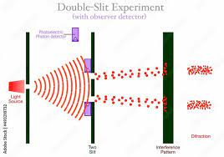
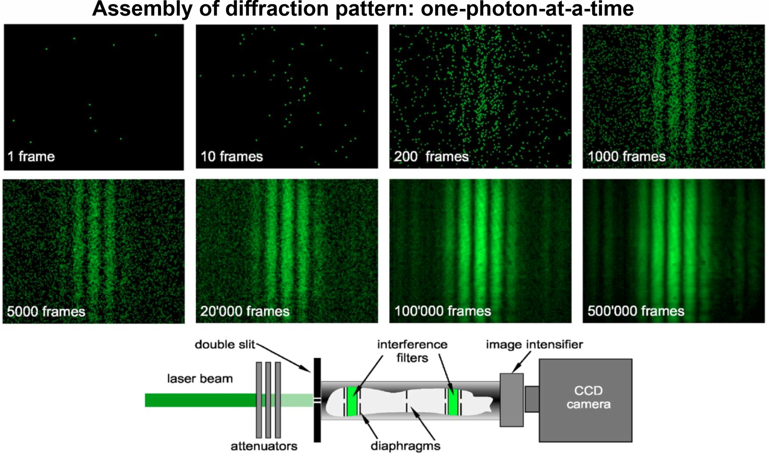
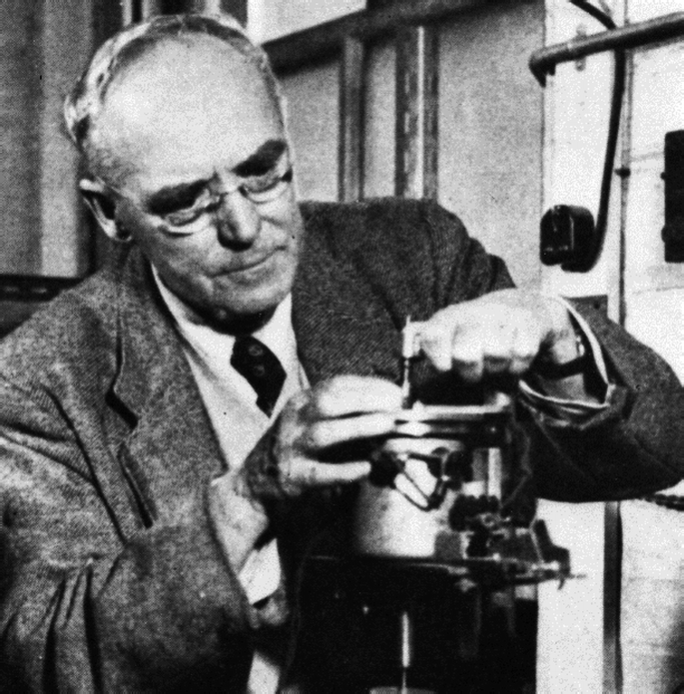
Wave-Particle Duality
Many gedanken, or “thought experiment”, variations on the double slit experiment were created to determine whether light was a wave or a particle.
Single photon interference-light enters the double slits one photon at a time and an interference pattern is again created, albeit one dot of light at a time.
This was experimentally verified in 1909 by Sir Geoffrey Ingram Taylor.
If, however, one of the slits was covered, the interference pattern goes away.
“Which-way” experiment-proposed by Richard Feynman, detectors are placed to measure which slit the photon went through and the interference pattern is replaced with two bright dots
This exact experiment has never been, and cannot be, performed since measuring the path of the photon destroys the photon.
However, an experiment very similar to this has been done and we will talk about it shortly.
These experiments brought about the principle of complementarity and the wave-particle duality.

Slide 6
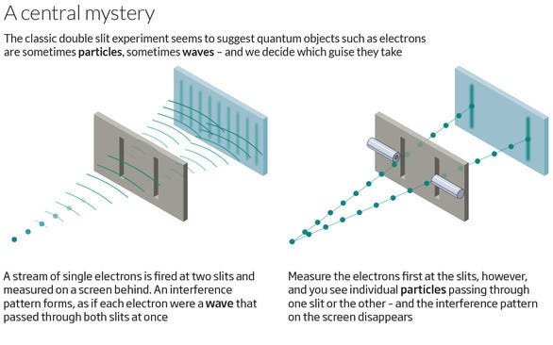
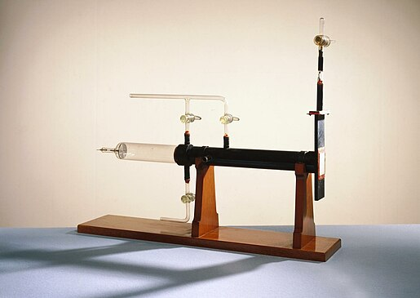
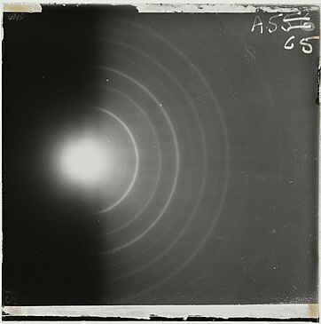
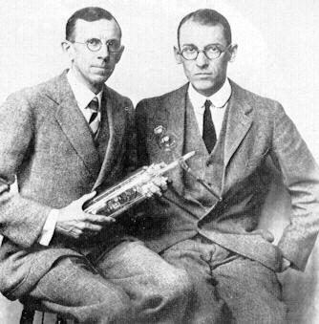
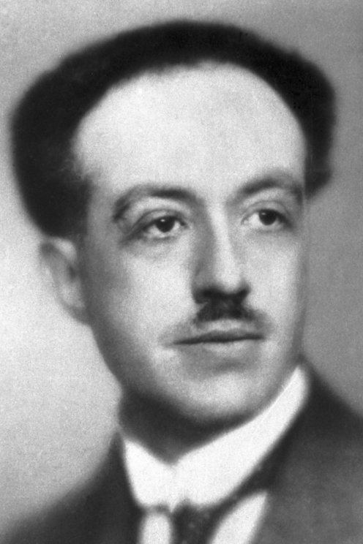
DeBroglie Waves
Seeing that light, what physicists used to think solely as a wave, now had some particle properties, could things that were thought to be particles actually have wave properties?
This was the major topic of Louis deBroglie’s Ph.D. thesis written in 1924, for which he received the Nobel Prize in Physics in 1929.
He postulated that all particles should have a wavelength associated with them, now called the deBroglie wavelength
$$λ=\frac{h}{mv}$$
where $h=6.6 × {10}^{−34} Joule∙seconds$ is Planck’s constant.
For most macroscopic objects, the wavelength was much too small to be detected.
However, for a typical electron, the wavelength is on the order of a few nanometers.
The wave nature of electrons was first measured by Thomson and Reid and Davisson and Germer in 1927 (Davisson & Germer won the 1937 Nobel Prize in Physics).
Eventually experiments similar to the double-slit experiment were done for electrons, protons and neutrons as well as molecules up to a mass of 25,000 a.m.u.’s!
Included in these was passing a single electron through two-slits.

Slide 7
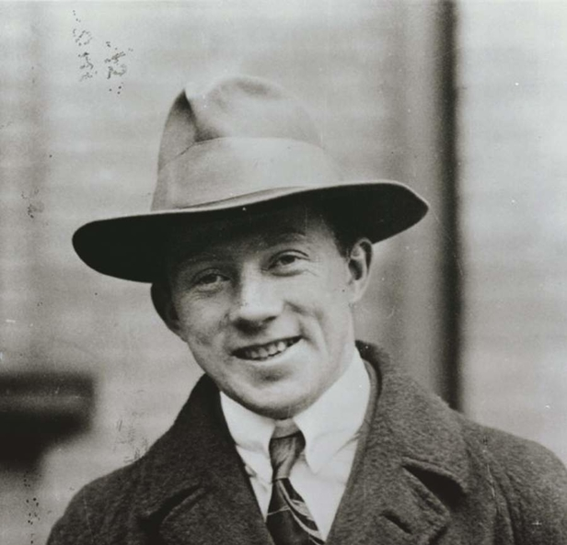
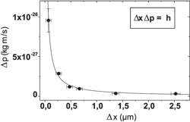
The Uncertainty Principle
As suggested by Feynman’s thought experiment, the act of measuring changes the state of the system being measured.
This is because you can’t make a measurement without interacting with the system being measured.
Because of this, all “particles”, matter and light alike, have an uncertainty associated with them.
The more we know about their position, the less certain we are about their momentum and vice versa.
This was first put forth by Heisenberg in 1927 and is known as his uncertainty principle. It can be stated mathematically as
$$∆x∙∆p≥\frac{h}{4π}$$
Other uncertainty relations can be formulated between angular position and angular momentum as well as between energy and time.
This principle has been subsequently verified in the diffraction of light, the Mossbauer effect with nuclear lifetimes, the spread of fullerene momenta and the measurement of nuclear spins.

Slide 8
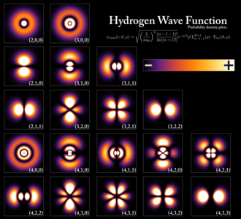
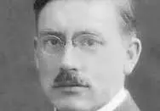
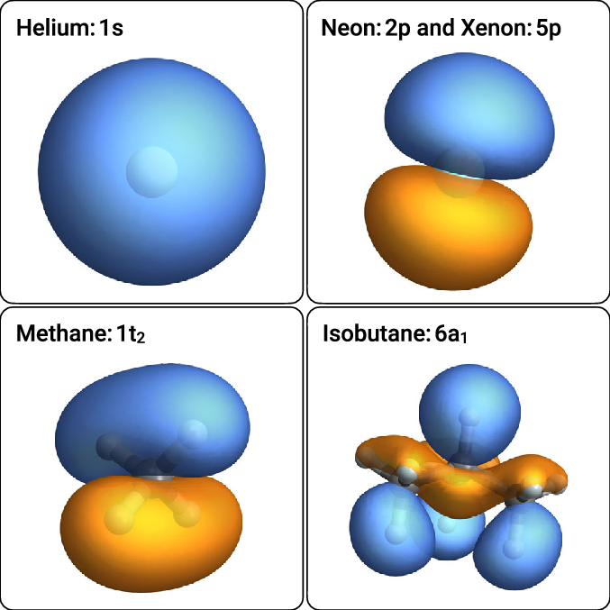
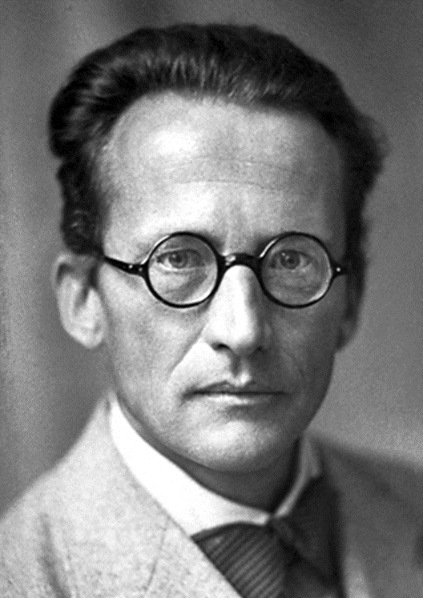
The Schr$\ddot{o}$dinger Equation
If there is uncertainty in the position and/or momentum of matter particles, and they have wave properties, how do we predict their future behavior?
For classical particles, we can just use Newton’s 2nd law. ($F=m\frac{d^{2}x}{dt^{2}}$) What about for quantum objects that have wave and particle properties (i.e. wavicles)?
Physicist Peter Debye stated that if matter really had wave properties then there should be a wave equation describing the evolution of matter in time.
In 1926, Erwin Schr$\ddot{o}$dinger derived just such an equation which now bears his name and is given by
$$\frac{ih}{2π}\frac{∂ψ(r, t)}{∂t}=−\frac{h^{2}}{8π^{2}m}∇^{2}ψ(r,t)+V(r,t)ψ(r, t)$$
where $ψ$ is called the wavefunction of the “particle”.
His equation gave similar predictions for the hydrogen atom as Bohr, but was also able to predict correct wave functions for atoms with more than one electron.
This would win him half of the Nobel Prize in Physics in 1933.
The wavefunction assigns a complex number to every point in space.
But what does $ψ$ actually represent?

Slide 9
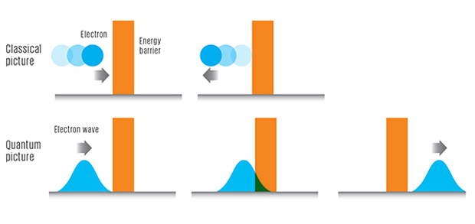
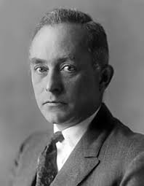
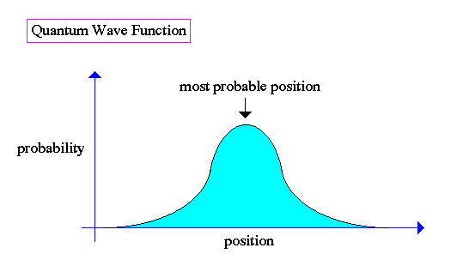
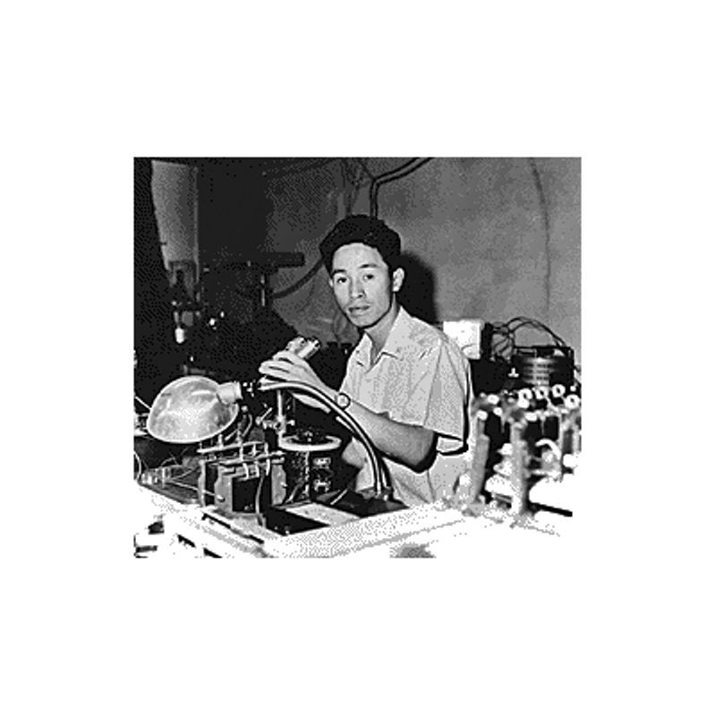
Probability Waves
If elementary particles actually have wave characteristics, then what is waving?
It turns out that $ψ$ is the particle amplitude and is usually complex-valued. As such it has no physical relevance.
Schr$\ddot{o}$dinger thought that ${|ψ|}^{2}$ was proportional to the charge density.
However, this interpretation wouldn’t work for multiple particle configurations.
In 1926, shortly after Schr$\ddot{o}$dinger published his equation, Max Born solved it for a scattering problem and stated that ${|ψ|}^{2}$ was proportional to the probability of finding the particle in a particular region of space.
This interpretation is known as the Born rule and is the current way physicists think of the wavefunction.
Using the Born rule one can derive the single electron interference pattern produced in the double-slit experiment as well as other such experiments.
Born won the Nobel Prize in Physics in 1954 for this and other work.
This probability interpretation gives rise to quantum tunneling, an effect demonstrated in 1957 by Leo Esaki with his creation of the semiconducting diode.

Slide 10
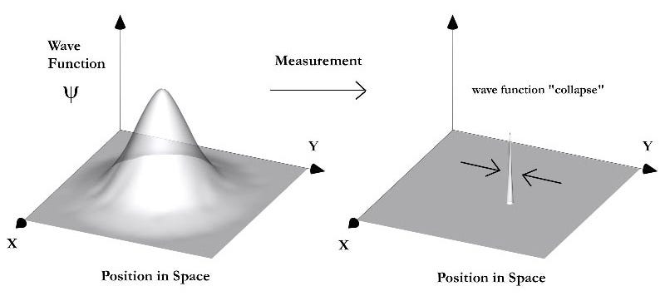
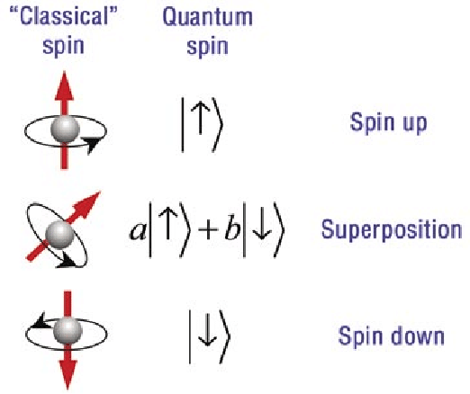
The Copenhagen Interpretation
Wave-particle duality, uncertainty, probability, what did it all mean?
Between 1925 and 1927, Bohr, Heisenberg, Born and others came up with different ideas that, today, are meshed together under the title of the Copenhagen interpretation of quantum mechanics.
In a nutshell it states that an elementary particle has no definite properties until those properties are “measured”.
Before measurement the wavefunction of the particle exists as a superposition of all possible values of each property, some with a greater probability of being measured than others.
When a particular property is measured, the wavefunction “collapses” into 100% certainty of a particular value.
Once the measurement is over and the particle is no longer being “observed”, it’s wavefunction starts to spread and it again becomes a superposition of states, only to be definite upon the next measurement.

Slide 11
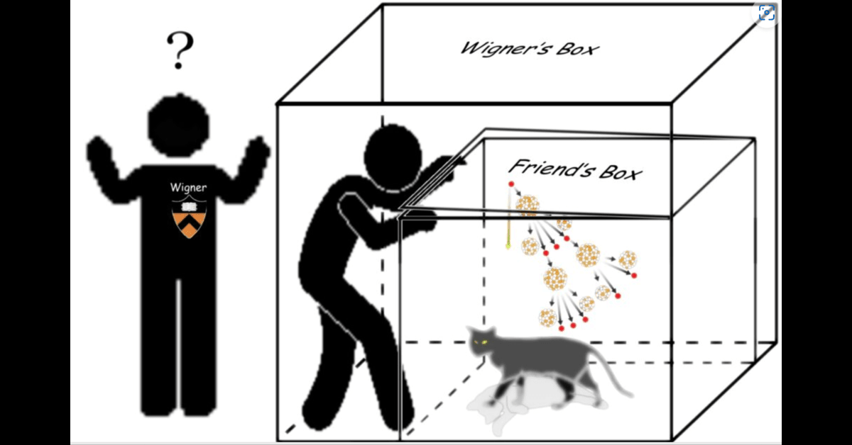
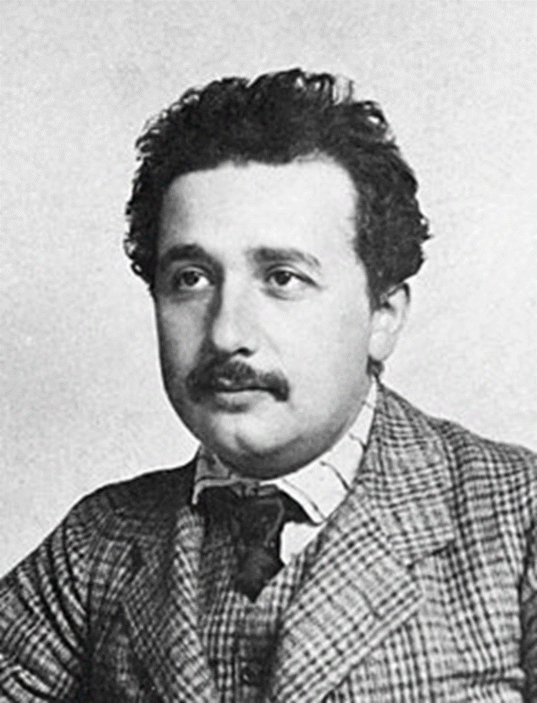
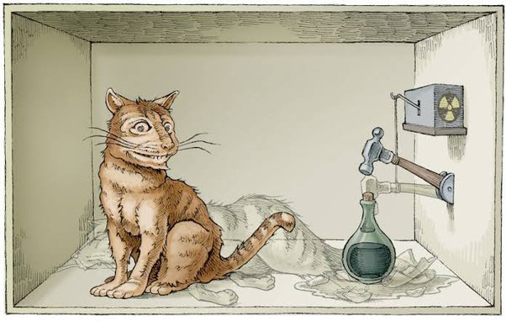
Opponents of Copenhagen
Not everyone agreed with this probabilistic interpretation of quantum theory.
The fact that measurement or “observation” brought reality into being disturbed many physicists.
Einstein is quoted as saying “God does not throw dice with the universe” as well as “I like to think the Moon is there even when I’m not looking at it” in order to voice his displeasure with Born’s rule and the so-called “measurement problem”.
As we saw at the beginning, Schr$\ddot{o}$dinger distanced himself from the ideas of superposition and measurement, even introducing his famous cat in order to note how ludicrous it all was.
Eugene Wigner was also not a fan of the collapse of the wave-function and tried to stress the kind of paradoxes that existed by introducing his “friend”.
Thus “when” the collapse “happened” was arbitrary.
This allowed people to state that it occurred once a conscious observer acted.
Quantum decoherence has replaced this notion of “conscious collapse”.
However, the actual process of measurement is still outside the realm of quantum physics since it is not readily describable by a mathematical operator or observable.

Slide 12
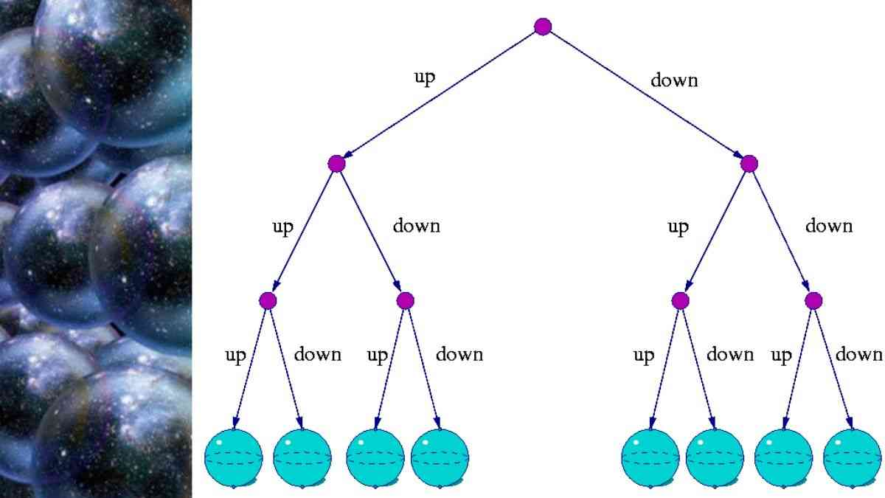
Alternative Interpretations
Two other major interpretations of quantum mechanics exist that explain what’s going on without referring to the collapse of the wavefunction.
In 1927 de Broglie, and later in 1952 David Bohm, independently came up with the “pilot-wave” interpretation, one containing so-called “hidden variables”.
Thus all particles have waves associated with them which are non-locally connected and, therefore, have definite positions and momenta that are not measureable by experiments. Thus the measurement problem is exchanged for non-locality.
In 1957, Hugh Everett proposed the “many-worlds” interpretation of quantum mechanics.
In it, the probabilistic interpretation of the wavefunction remains, but there is no collapse.
Instead, at each quantum “decision” the universe branches into multiple copies of itself, one for each outcome. So all possible outcomes become reality, just in different universes!

Slide 13
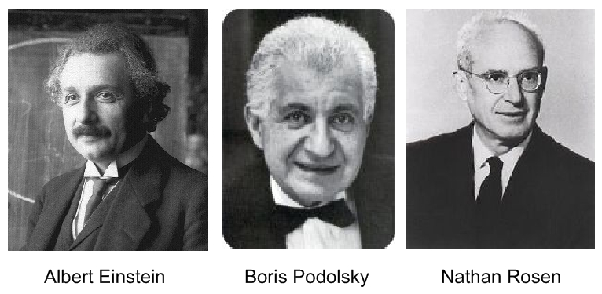
The EPR Paradox
In 1935, Einstein, along with his postdoctorate researchers Podolsky and Rosen, authored a paper that was thought to show, once and for all, that quantum mechanics was incomplete.
The experiment proposed in the EPR paper is fairly complicated, but Bohm created a variation of it in 1951 that is much simpler to explain.
Suppose an electron-positron pair are created in a singlet state, meaning their spins, when measured in a particular direction, are opposite.
If quantum mechanics is correct, when the pair is created they are both in a superposition of up and down states, a 50% chance of being in either state.
Now let the particles get so far apart from each other that they can’t causally affect each other and measure the spin of one of the particles.
Instantly, you know the spin of the other particle, regardless of how far away it is from the other particle.
Einstein called this “spooky action at a distance” and thought this would show the incompleteness of quantum theory and that each particle had to have a definite spin at the time of their creation.

Slide 14
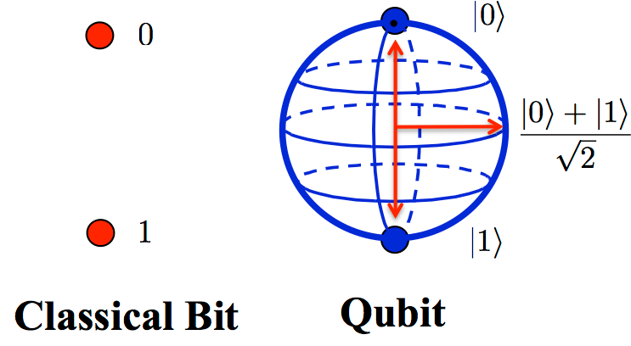
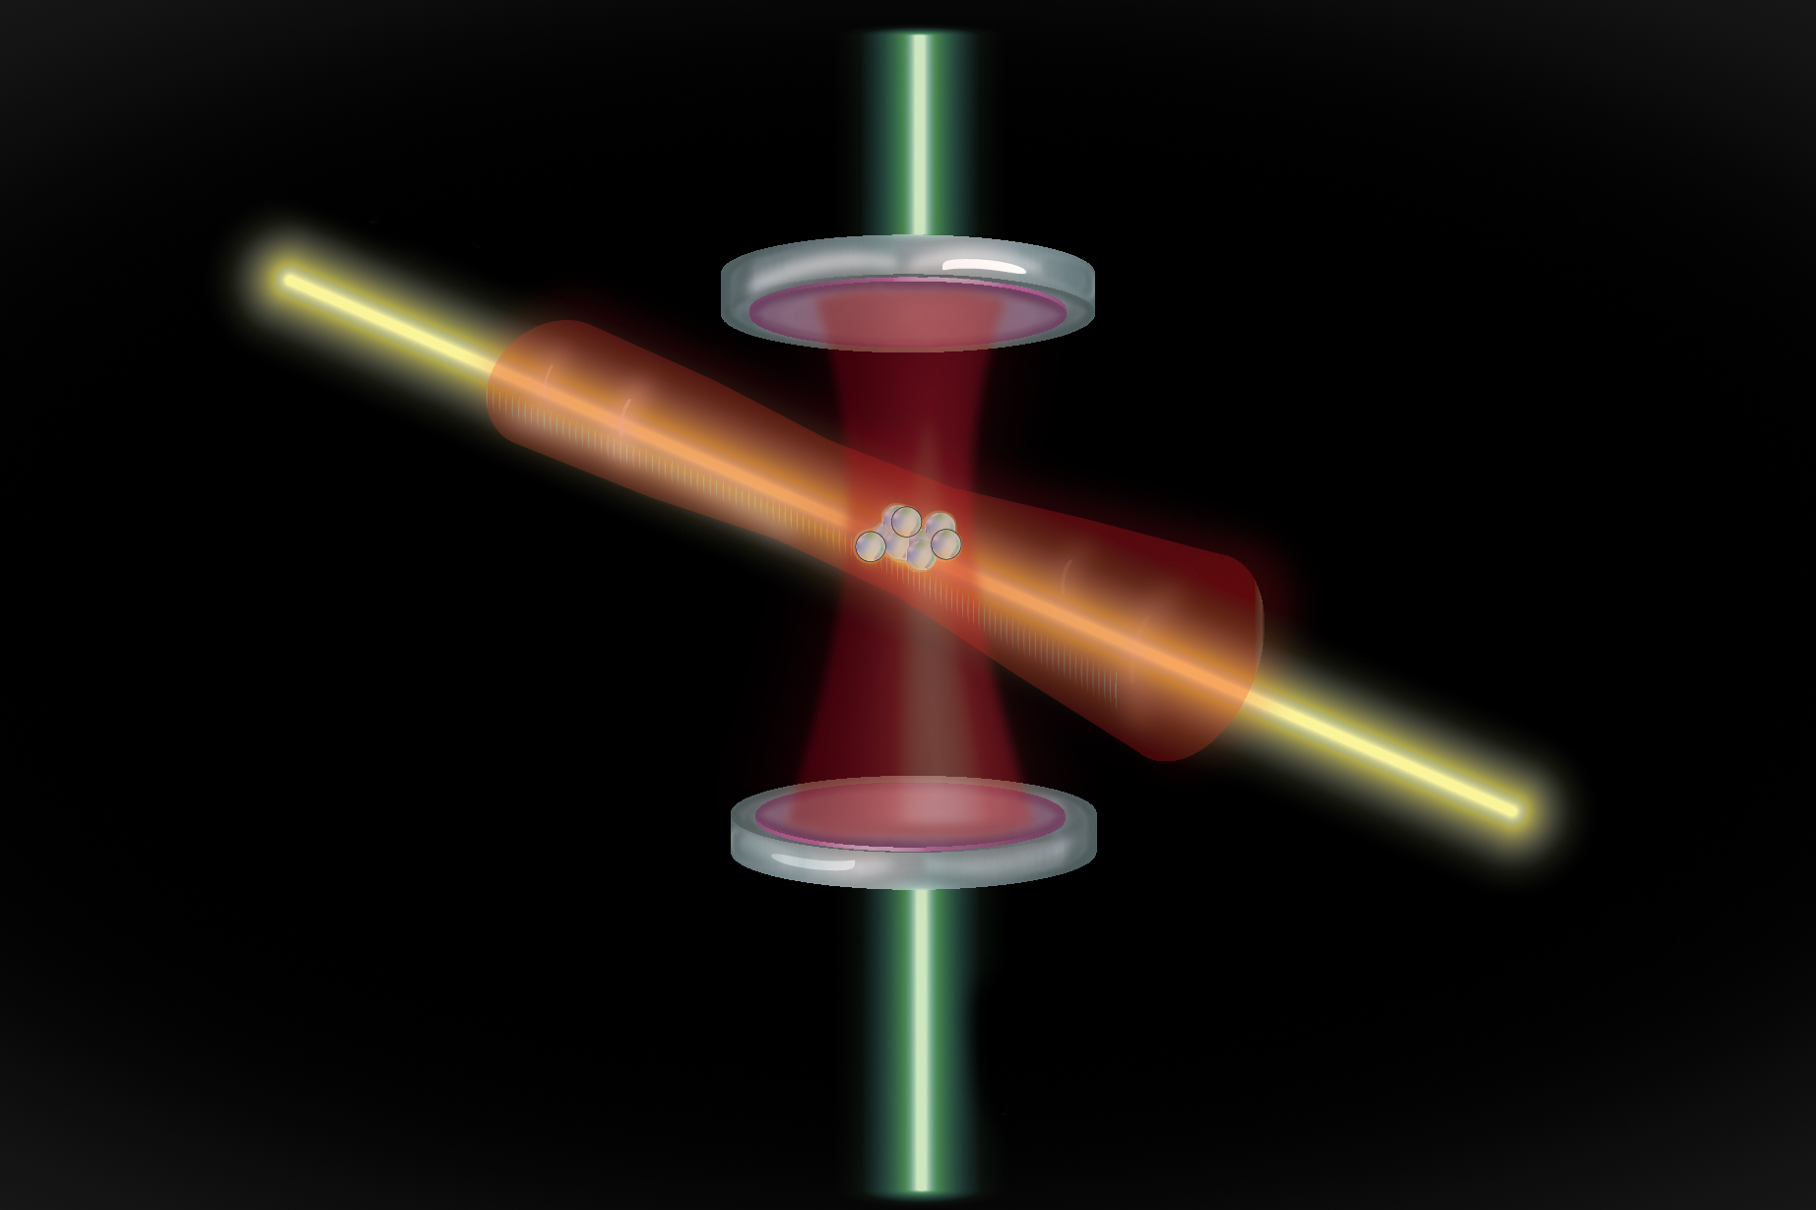
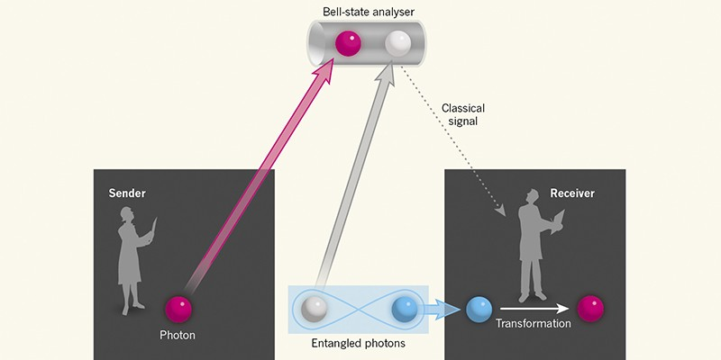
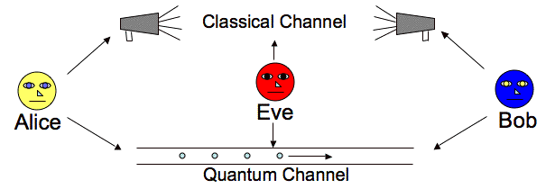
Entanglement
Shortly after the EPR paper was published, Schr$\ddot{o}$dinger published a paper referring to the particles in the thought experiment as “entangled”.
Einstein elevated this “quantum entanglement” as “not one but the characteristic trait of quantum mechanics, the one that enforces its entire departure from classical lines of thought.”
Today, quantum entanglement is a foregone conclusion, having been used in a variety of experiments including:
Quantum key distribution
Quantum teleportation
Ultra-precise atomic clocks
Quantum computing
But how was this counter-intuitive concept shown to be correct and Einstein shown to be incorrect?

Slide 15
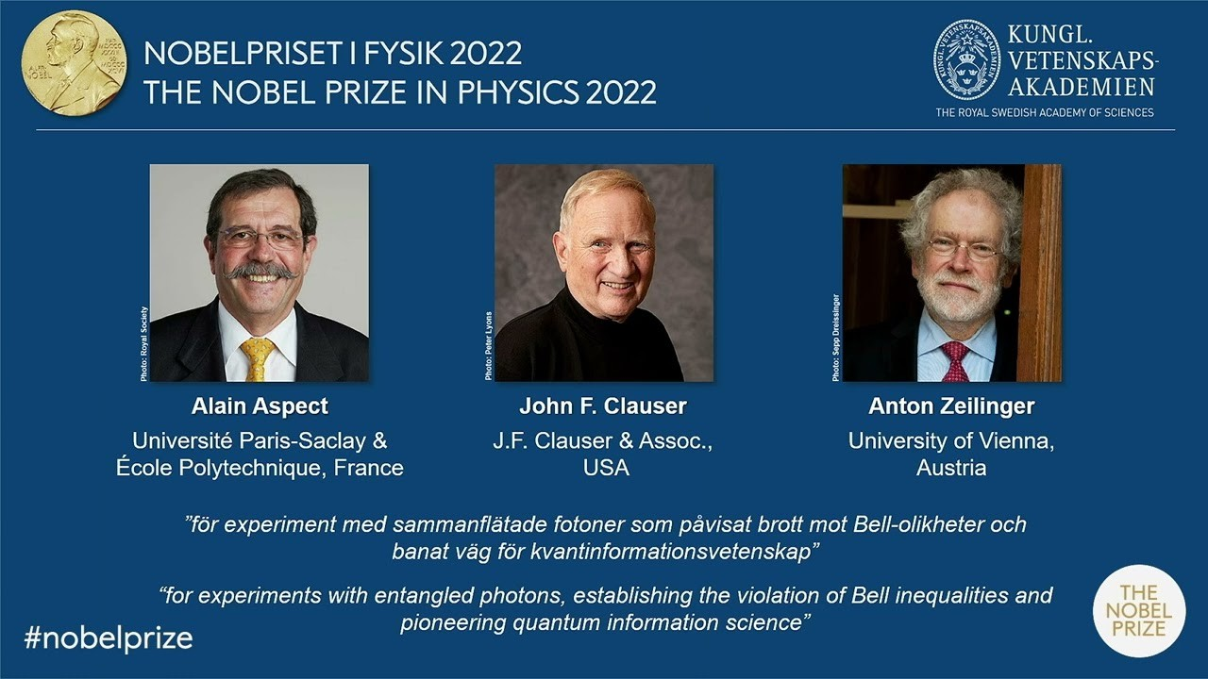
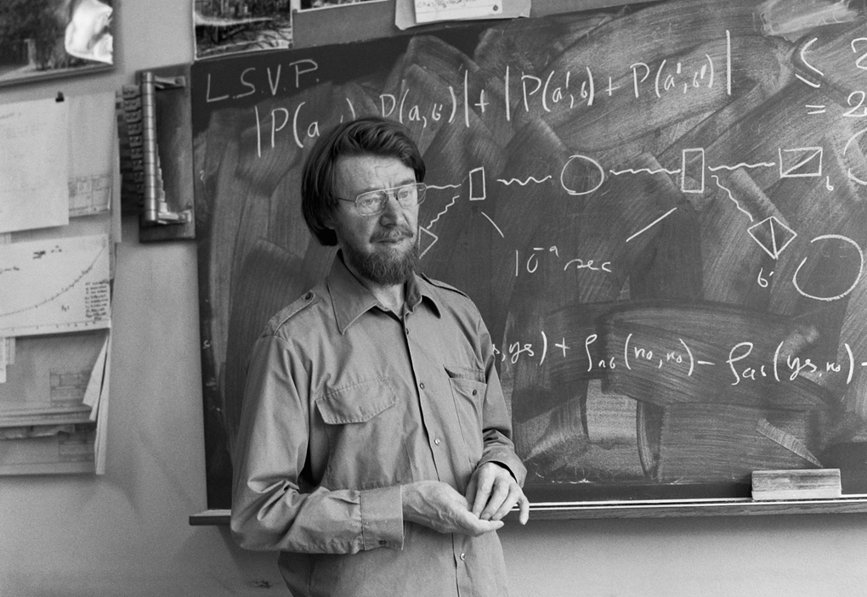
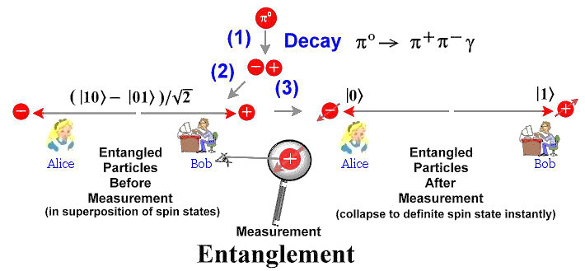
Bell’s Inequality
Imagine electron-positron pairs are randomly created in a singlet state.
Alice receives the electrons and Bob receives the positrons at locations on opposite sides of the Milky Way.
Each observer is free to pick the $x$, $y$ or $z$ direction to measure the spin of their particle. They each decide to do so randomly.
If the spins in all three directions are imprinted at the moment of creation, then there are eight possible configurations of the two particles.
The probabilities of three different experimental results are given below.
$P\left(e_{x} +, p_{y}+\right)=\frac{N_{3}+N_{4}}{N}$; $P\left(e_{x} +, p_{z}+\right)=\frac{N_{2}+N_{4}}{N}$; $P\left(e_{z} +, p_{y}+\right)=\frac{N_{3}+N_{7}}{N}$
From the right-hand side of these equalities, it is obvious that
$$P\left(e_{x} +, p_{y}+\right)≤P\left(e_{x} +, p_{z}+\right)+P\left(e_{z} +, p_{y}+\right)$$
This is one of many possible formulations of Bell’s Theorem, first put forward by John Bell in 1964.
John Clauser in 1972, Alain Aspect in 1982 and Anton Zeilinger in 2000 all performed experiments that showed that Bell’s inequality is violated in nature.
Thus, either there are hidden variables that violate locality, or the particle spins were in a superposition of states until they were measured, not as was pictured in the table!
Number of Particles | Electron Configuration | Positron Configuration
N1 | (x+, y+, z+) | (x-, y-, z-)
N2 | (x+, y+, z-) | (x-, y-, z+)
N3 | (x+, y-, z+) | (x-, y+, z-)
N4 | (x+, y-, z-) | (x-, y+, z+)
N5 | (x-, y+, z+) | (x+, y-, z-)
N6 | (x-, y+, z-) | (x+, y-, z+)
N7 | (x-, y-, z+) | (x+, y+, z-)
N8 | (x-, y-, z-) | (x+, y+, z+)

Slide 16
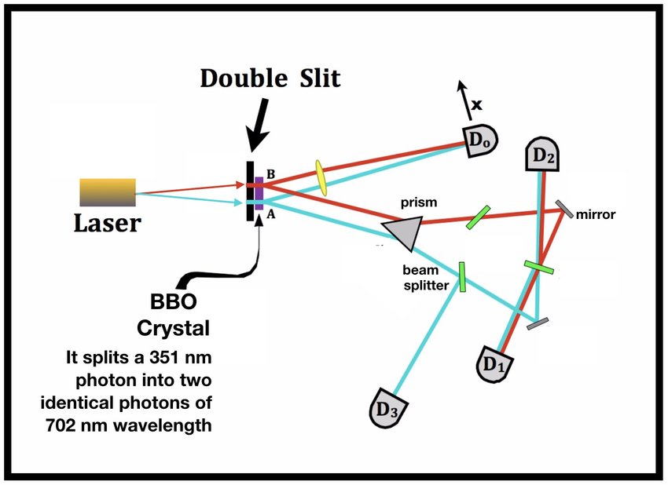
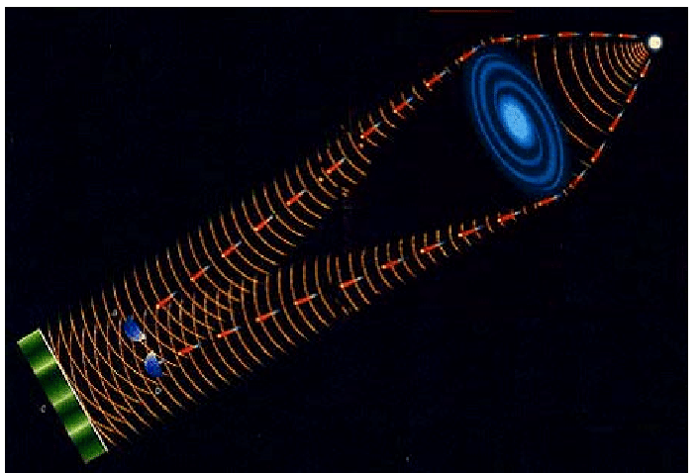
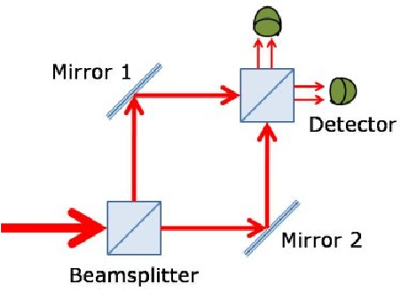
Modern Experiments
Delayed Choice-first conceived by John Wheeler in 1978, the point is to wait until after the particle has “decided” to act like a wave or particle and then change the experimental setup so that the particle “chose” wrong.
Experimental verification came in 1987 from multiple groups and it verified that whatever the setup was when the particle was detected determined whether the particle or wave nature was seen.
Again, this means that either there is no objective reality or that there was some kind of retrocausality at work. Most physicists favor the first option.
Quantum Eraser-first proposed in 1982 by Scully and Dr$\ddot{u}$hl, this experiment uses entangled photons, measuring one to get information out about the other one without directly measuring it, effectively “erasing” any which-way information that is obtained and recovering the interference pattern
This was experimentally verified in 1992 by Kwiat, Steinberg and Chiao.
The two experiments can be combined into the delayed choice quantum eraser in which the decision to erase the information comes after passage through the slits. The experiment was first performed in 1998 and quantum weirdness was again verified.

Slide 17
Final Thoughts
Quantum theory makes very accurate predictions.
As of February, 2023, the record is the magnetic moment of the electron whose measurement agrees with theory to within one part in 8 trillion or ~${10}^{−13}$!
However, what is actually going on at the quantum level is still hotly debated.
The main thing left to be done with quantum mechanics is to merge it with general relativity.
Many attempts have been made, with varying degrees of success (loop quantum gravity, causal dynamical triangulations, spin-foams etc.) but none of them have been shown to be the quantum theory of gravity.
Perhaps we’ve been looking at it the wrong way this whole time: ER=EPR.
Grad school story

