Slide 1
Quantitative Modeling of Cardiac Metabolism
PET Imaging and Image Analysis – A Software Package
Software Engineer: ratnakar amaravadi
Principal Investigator: Gary D. Hutchins, PhD.

Slide 2
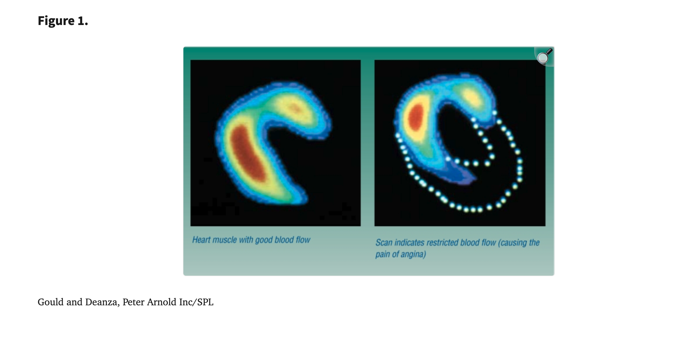
PET Scan Image from a Heart Scan

Slide 3
What is Positron Emission Tomography?
Positron emission tomography (PET) is a non-invasive imaging test that measures metabolic activity and function in tissues by tracking a small amount of injected radioactive tracer. It excels at detecting cancer, heart disease, and brain disorders early, often revealing cellular changes before structural damage is visible on CT or MRI.
Need an in-house Cyclotron to make short lived radioistopes / radioactive tracers/tags

Slide 4
Key Aspects of PET Scans:
How it Works: A radioactive tracer (like Fluorine-18) is injected, which accumulates in cells with high metabolic activity, such as cancer cells. A scanner detects positrons emitted by the tracer, creating 3D images. (Image Reconstruction)
Pixel densities in Images – representative of glucose uptake / tracer uptake / concentrations

Slide 5
Common Uses:
Cancer: Detecting tumors, staging cancer, determining if cancer has spread, and evaluating treatment effectiveness.
Brain Disorders: Identifying Alzheimer's disease, dementia, epilepsy, and brain tumors. (Separate Software Engineer)
Heart Disease: Assessing blood flow and damage to the heart muscle.
My role was to develop software tools needed to support studies / research to understand cardiac metabolism/kinetics.
Project funding ~$5-million, 5-year RO-1 grant. Collaborators: Cardiologists/Surgeons, Chemists, Molecular Biologists, Radiologists, Radiochemists, and PI/Gary Hutchins – Medical Physicist

Slide 6
Procedure Details & Preparation:
PET scans are outpatient procedures, taking
about 10–40 minutes to scan, often combined with CT scans (PET/CT)
For anatomical accuracy.
Patients may need to fast or stop taking certain
medications before the scan to ensure accurate results, as
blood sugar levels can affect the image.
Often, PET scans are combined with CT scans to pinpoint the
precise location of metabolic abnormalities.

Slide 7
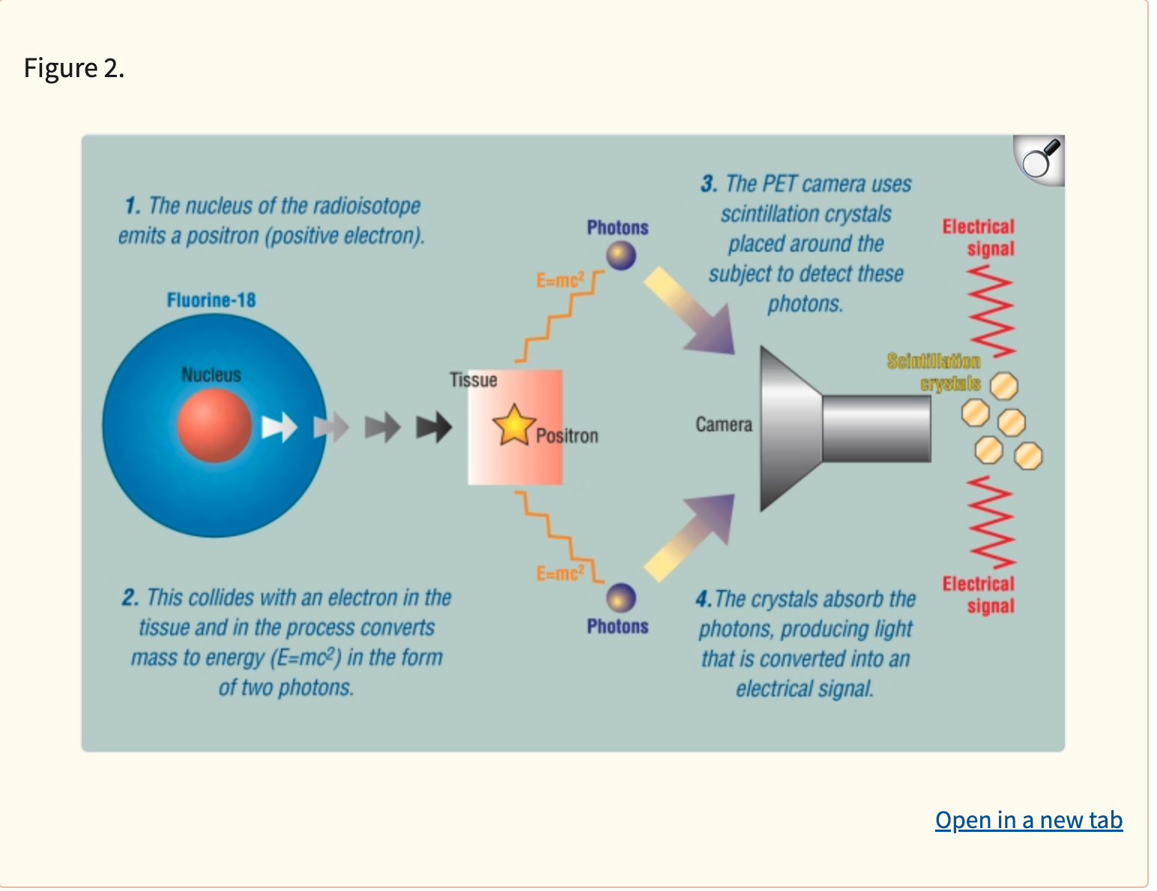
How a PET Scanner works.

Slide 8
PET Scans and Quantitative Medicine
PET scans take 10-40 minutes to complete. They are painless, and, as for computed tomography, the patient is fully clothed.
A common use for PET is to measure the rate of consumption of glucose in different parts of the body.
Accumulation of the radiolabeled glucose analogue 18-fluorodeoxyglucose (FDG) allows measurement of the rate of consumption of glucose. One clinical use of this is to distinguish between benign and malignant tumors (malignant tumors metabolize glucose at a faster rate than benign tumors). Whole body scans are often performed to stage a cancer.

Slide 9
PET Scans and Quantitative Medicine
Other applications of PET include looking at the blood flow and oxygen consumption in different parts of the brain—for example, in understanding strokes and dementia. Tracking chemical neurotransmitters (such as dopamine, in Parkinson's disease) can also be performed with this technique.
PET has further applications in cardiology (in pre-transplantation assessment of viable myocardium), in distinguishing recurrent tumors from radiation necrosis and surgical scarring, and in a variety of cancers.

Slide 10
Pharmacokinetic Compartment Models
Glucose uptake in tissue is modeled with a System of Linear First order Ordinary differential equations.
Solutions to the the ODEs are Sums of Exponentials with Metabolic rate constants & relevant physiology parameters embedded in the exponents, coefficients of the solutions to the ODEs.
The ODEs describe the glucose uptake/ mass transfer between a central and peripheral compartment, resulting in two connected equations – one for the change in FDG concentration in the central compartment, and another for change in FDG concentration in the peripheral compartment.

Slide 11
One and Two Compartment Kinetic Models
https://www.youtube.com/watch?v=3ygsMD6DMFI
https://www.youtube.com/watch?v=TIYIwSfxikU
https://www.youtube.com/watch?v=rxd9je6mDeA
Time Activity Curves and Kinetic Modeling tools

Slide 12
Two Compartment Model

Slide 13
Solution to 1 and 2 compartment models
Single exponential term vs. sums of exponentials.
Aexp(-Bt) + Cexp(-Dt)
The curve fitting process determines optimal A, B, C, D values.
Uses Marquardt Algorithm from Nuclear Physics experiments, or a Look-up table approach with interpolation of parameters
Hypothesis: There is an optimal set of parameters for healthy cardiac tissue vs. sub-optimal parameters for diseased tissue.
When such characterization is possible, it would help Cardiologists Surgeons to decide whether to cut open or not.

Slide 14
Solution Process
The solutions to the ODEs are essentially sums of exponentials.
The end goal / function of software analysis tool was to do curve fitting / fitting sums of exponentials to the FDG concentration time series data accumulated by the scanner.
The goals of the research program depended on software tools that were developed inhouse. (Department of Radiology at IUSM)
The Software packed was later shared with researchers at other institutions – University of Pittsburgh Medical Center, and Yale University School of Medicine, apart from its use at IUSM/Kranert Institute of Cardiology.

Slide 15
Structure, Processes, & System of ODEs
Structure: They describe the rate of change of substance (FDG) in both compartments
Processes: The models use kinetic rate constants k1, k2, k3, k4 to represent FDG uptake and subsequent depletion of FDG from tissue.
System of ODEs: It is a coupled system; change in FDG concentration in one compartment depends on the concentration in the other compartment.
The PET scanner collected time slices of spatial FDG concentration data across the Left Ventricle in the heart.

Slide 16
My Role in this Project: Overview of Cardiac Analysis Package
A software package/set of tools were developed to analyze PET Scan Data from Cardiac Imaging. The tool set was developed over a span of 3.5 years using a prototyping software language called IDL – Interactive Data Language.
The software package was meant for research purposes only and was not used in routine clinical work by any of the practicing Cardiologists and Surgeons at IU School of Medicine/Kranert Institute of Cardiology.
The goal of the research program / RO-1 grant at IUSM/Dept of Radiology & Kranert Institute of Cardiology was to characterize healthy and diseased cardiac tissue in a quantitative manner with a set of reaction rate constants.

Slide 17
Multi-layer Software Processing of Data
Goal: To start with output from the Siemens PET scanner and to end up with a spatial distribution of kinetic/metabolic rate constants across various slices of the Left Ventricle.
The software package consists of 9 data processing modules – all written in IDL over a 3+ year time frame.
1: Interactive Reslicer Program. 2: Semi-Automatic Resampler
3: Integration Tool. 4: Normalization Tool.

Slide 18
Multi-layer Software Processing of Data
5: Polar Map Comparison Tool. 6: Database of Selected Subjects
7, 8: gif generation & Visual display tool for Short Axis slices.
9: Automated Curve Fitting Tool – Tracer Kinetic Analysis

Slide 19
Interactive Reslicer Program
This tool takes as its input static and dynamic scan files from the Siemens PET scanner.
The operator views transverse planes and allows the operator to define the axis of symmetry for the Left Ventricle.
The program recomputes a new image volume just covering the Left ventricle. The entire volume of the LV is stored as 12 slices.
The LV volume forms the short axis image file.
All further processing is done on the short axis image file.

Slide 20
Long Axis View Before LV definition

Slide 21
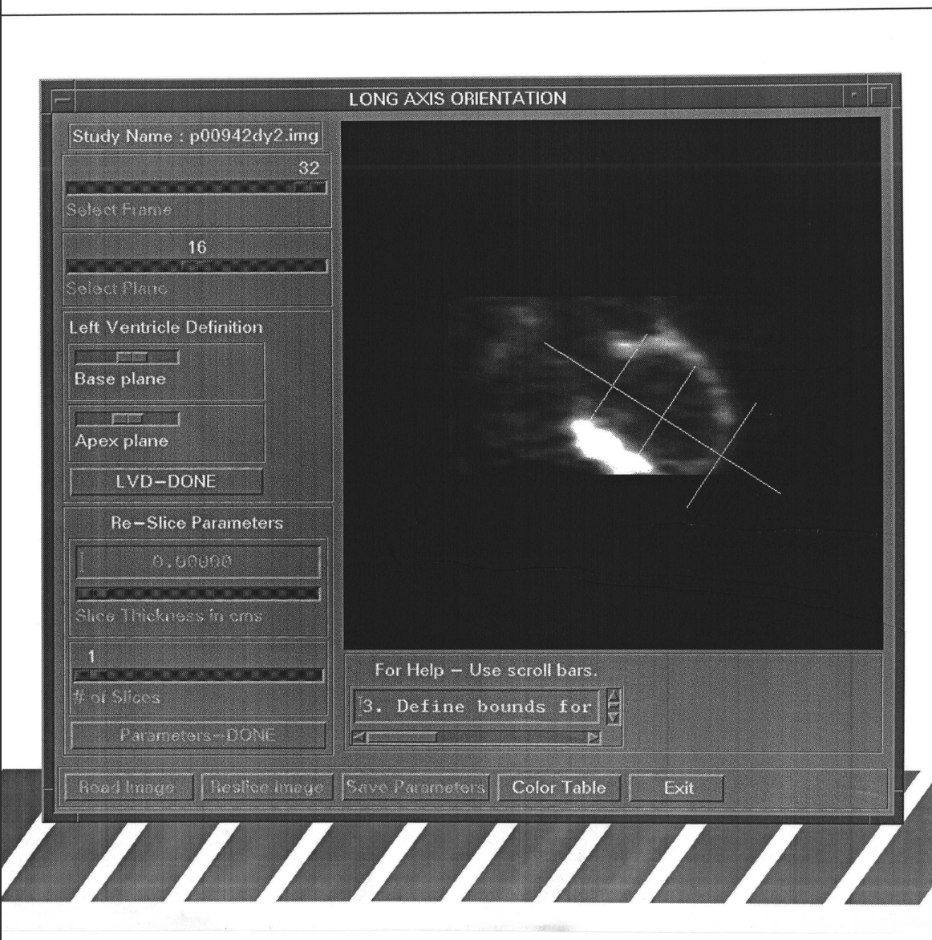
Long Axis Image of Left Ventricle

Slide 22
Short Axis Images

Slide 23
Left Ventricle Axis of Symmetry

Slide 24
Short Axis Image Viewer 12 slices of the Left Ventricle

Slide 25
Semi Automatic Resampler
This routine takes the short-axis image files and and outputs Tissue Curve files for each region of interest (ROI).
The Short Axis Images of the LV is 12 slices tall, each slice sampled for 16 ROIs. The apex is treated as one ROI. (Total of 177 ROIs across the whole LV.)
The first ROI in each slice is located at the LV-RV junction. Each slice is treated as inner and outer ellipses, between which is the Myocardium. Blood pool is in red, and myocardium in white.
A long Axis image is also presented to trace out the myocardium, and inner blood pool. Resampling parameters are saved and may be applied to various studies to have a uniform sampling patterns across all selected studies.

Slide 26
Interactive ROI Generation - 1

Slide 27
Interactive ROI Generation - 2

Slide 28
Regions of Interest on a Single Slice

Slide 29
Integration and Normalization Tools
This tool takes tissue curve data from a dynamic scan, and integrates tissue uptake over a specified time interval – start and end time frames.
Integration time windows are in the order of 300 – 1800 seconds for NH3 tracers, and 1880-3600 for FDG & HED.
After time integration of uptake data, a normalization is performed across various tracers.
A polar plot is generated to visualize the average uptake across each ROI over the entire LV. A polar plot is a squish of the LV onto a plane.

Slide 30
Comparison and Database Tools, Gif Image Generator
This tool lets an investigator compare a subject or a group of subjects against a selected control group. Parameters used for comparison are means and standard deviations for each ROI.
Multiple databases are maintained for uptake data for ROIs . Usually decided by an individual researcher/investigator.
Statistics for each ROI may also be visualized. ROIs are indexed from, 1 to 177. 1 – being the ROI at the LV-RV junction in the uppermost slice of the LV, and 177 being the Apex/lowest slice of the roughly ellipsoid shaped LV.
The Database Tool allows the investigator to build their own database of subjects.

Slide 31
Fitcom
This program computes Mean Blood Flow values, Retention fractions, Blood volumes, and kinetic rate constants k2 + k3 for each ROI
Curve Fitting Parameters mapped onto a Polar Plot.
A Polar Plot is analogous to a squish of ellipsoid (or paraboloid) cup onto a plane. The top of the Left Ventricle (basal slice) is the out most annulus of the polar plot. The Apex or the lowest plane of the LV maps onto the center of the polar plot.

Slide 32
Curve Fiting Module - 1

Slide 33
Curve Fiting Module - 2

Slide 34
Curve Fiting Module - 3

