Slide 1

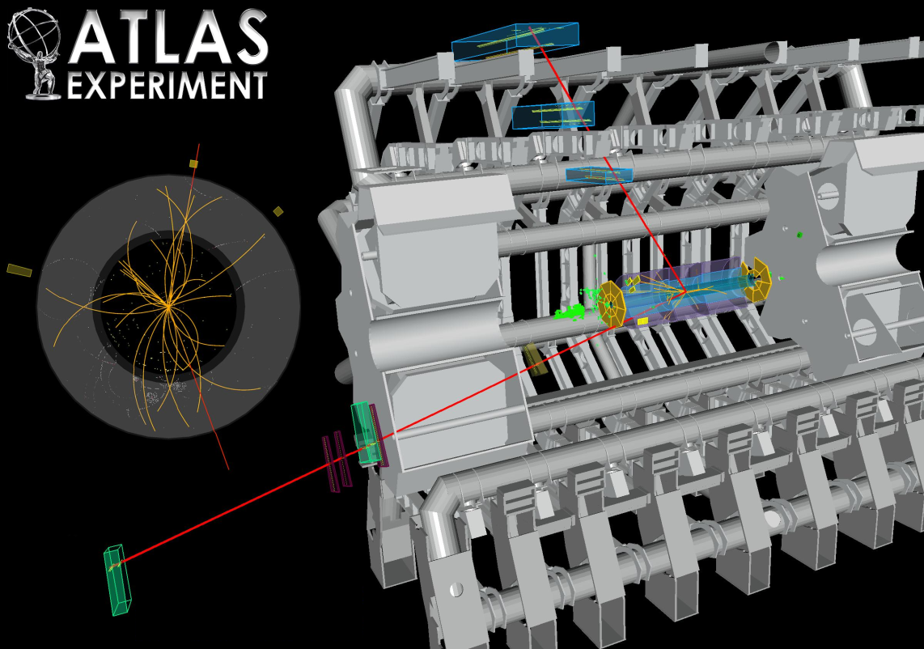
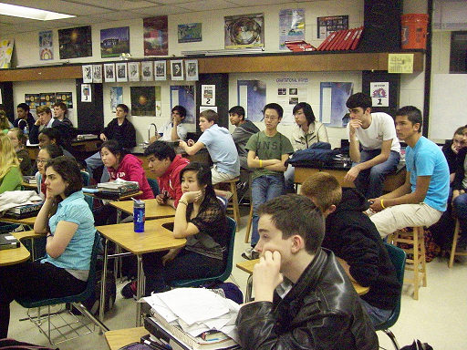


ATLAS Z-Path Masterclass

Slide 2
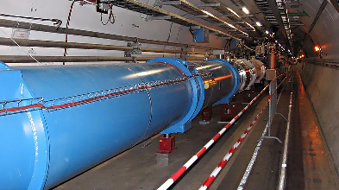
The LHC and New Physics
It’s a time of exciting new discoveries in particle physics!
At CERN, the LHC is
now in Run 3, with its highest collision rates and energies yet. At the same time, there are new questions as the few experimental results vary from the highly reliable Standard Model.
The LHC and CMS are where we need to be to explore these new mysteries.

Slide 3
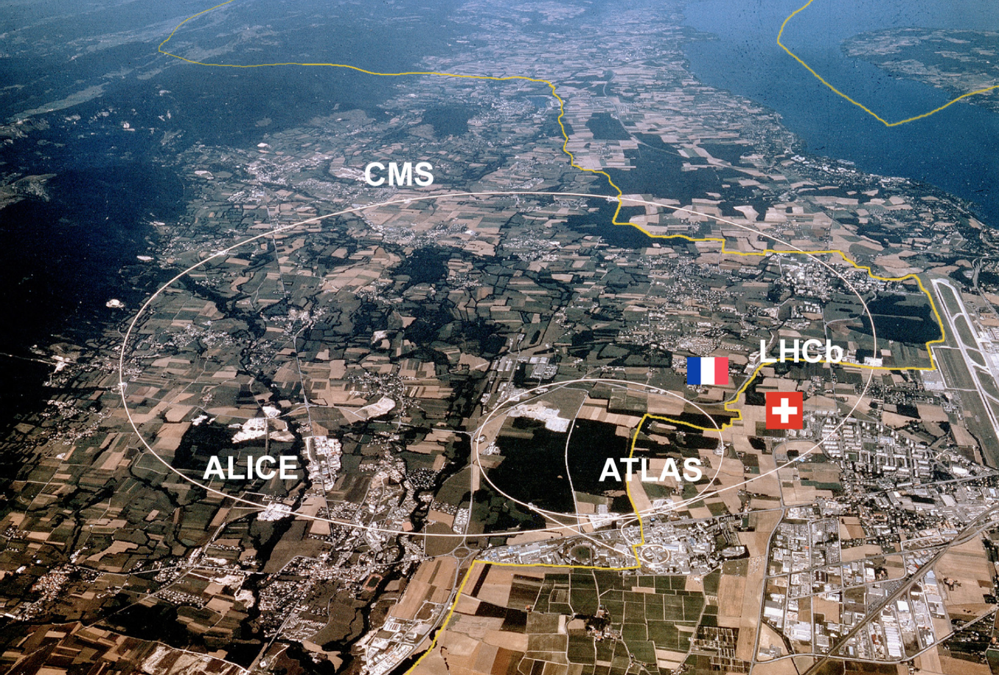
LHC@CERN
~27 km circumference
~100 m underground
Protons circulate in opposite directions
Up to 14 TeV collision energy

Slide 4
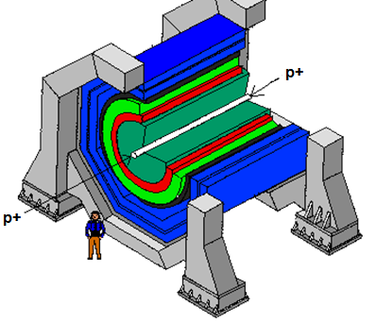
Detectors
Generic Design
  Cylinders wrapped around the beam pipe
  From inner to outer . . .
    Tracking
    Electromagnetic calorimeter
    Hadronic calorimeter
    Magnet*
    Muon chamber
    *Location of magnet depends on specific detector design.
Notes:
4

Slide 5
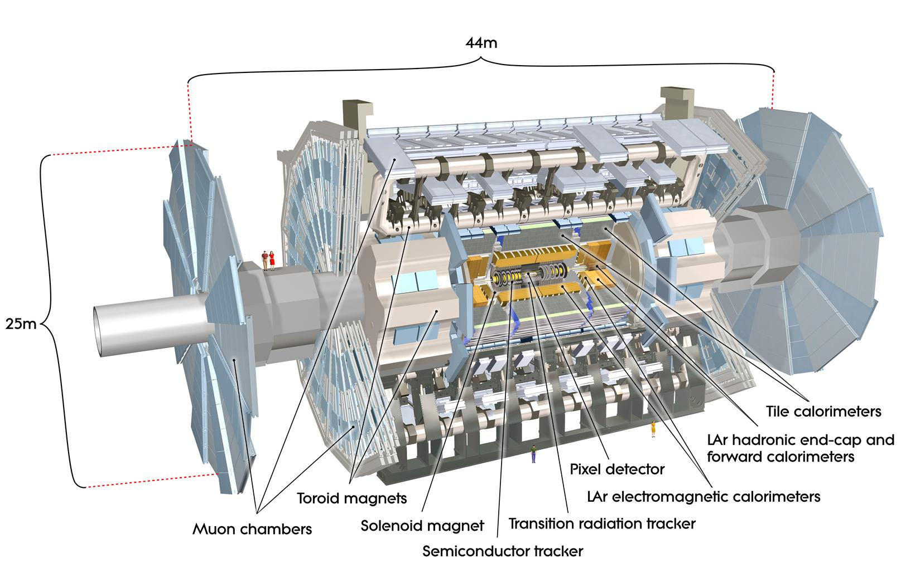
ATLAS Detector

Slide 6
ATLAS Detector

Slide 7
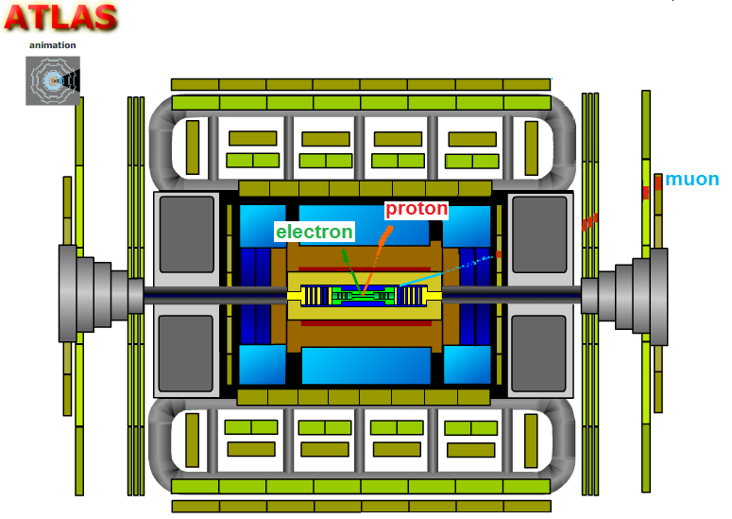
ATLAS Detector

Slide 8
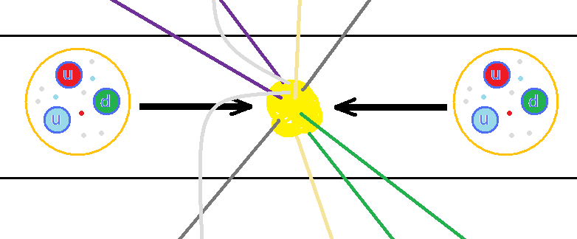
Protons collide inside ATLAS
The LHC accelerates protons to almost 7500 times the energy equivalent of their mass. The protons circulate in opposite directions and collide in the center of ATLAS.
But protons are not just particles: they are more like bags of quarks and gluons. When protons collide, all sorts of very short-lived particles can be made from all that energy.
Notes:
8

Slide 9
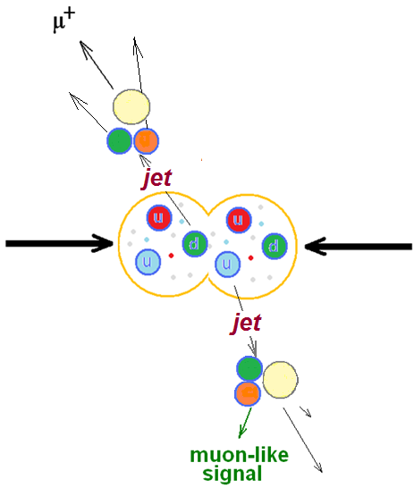
Particle Decays
Often, quarks are scattered in collisions.
As they separate, the binding energy between them converts to sprays of new particles called jets. Also, lower energy electrons and muons can emerge.
They are not what we are looking for.

Slide 10
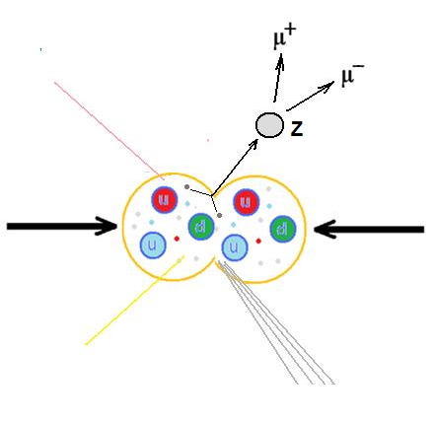
Particle Decays
We are looking for the Z boson, a particle with no charge that decays into two muons or two electrons.*
What do we know about the charges of the muons or electrons? What is the charge of the Z?
*The Z has other decays . . . but these are not what we are looking for.

Slide 11

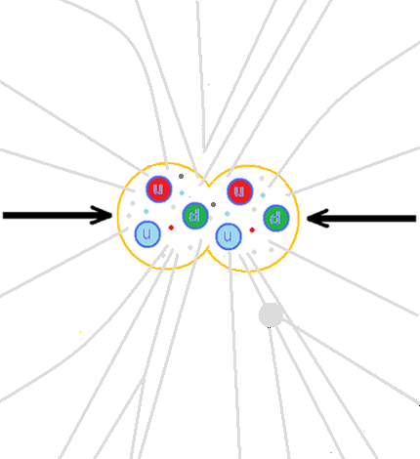
A “dimuon” or “dielectron” event might be a decay of the particle that we are interested in.
It may be hard to find the tracks we want unless we make a “cut” on low- energy tracks.

Slide 12
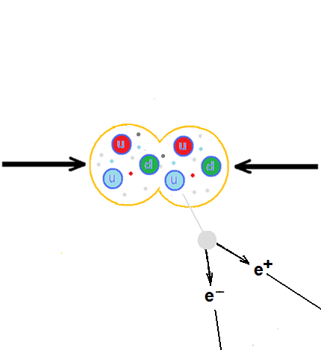
Particle Decays
If we cut out all tracks below, say, 5 GeV momentum, the picture is clearer.
Today, we will filter many events to find Z→e e and Z→μ μ signals and use momentum information from these to find the mass of the Z boson.

Slide 13
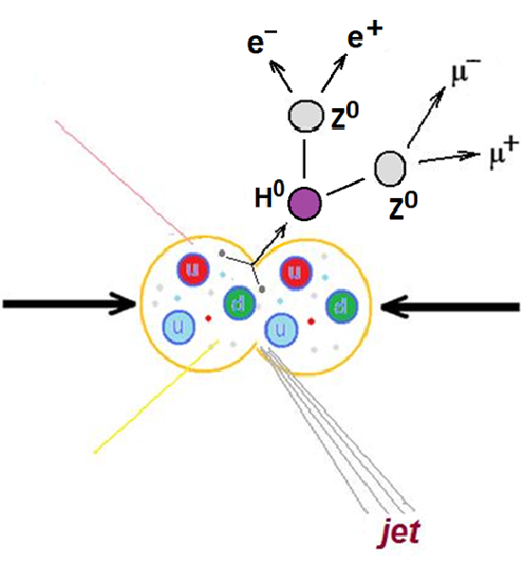
Particle Decays
The Higgs boson was discovered by CMS and ATLAS and announced on July 4, 2012.
This long-sought particle is part of the “Higgs mechanism” that accounts for other particle having mass.

Slide 14
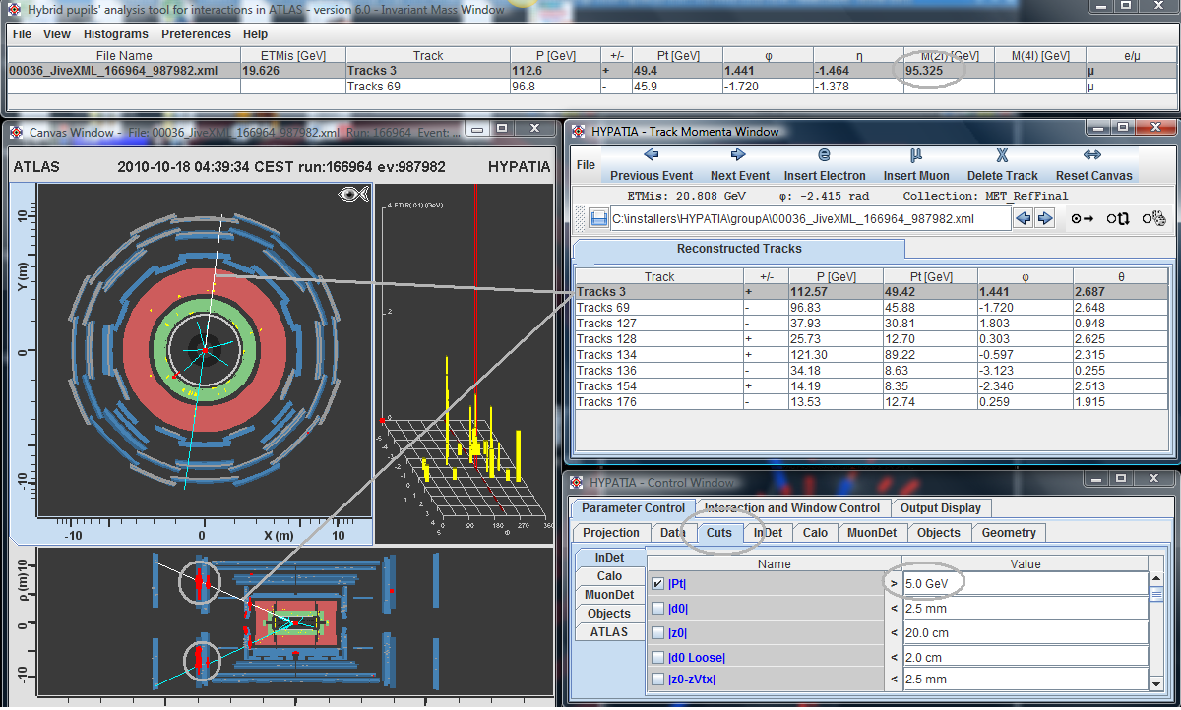
HYPATIA Event Display

Slide 15
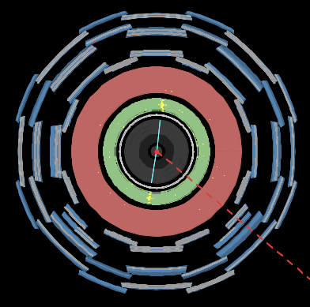
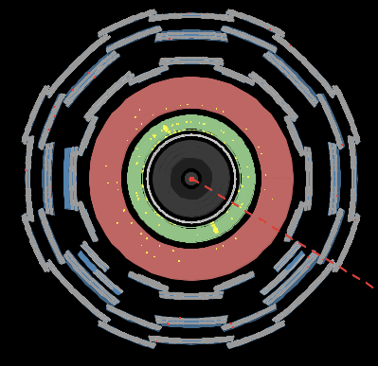
HYPATIA Event Display
How are these events similar? Different? Why?

Slide 16
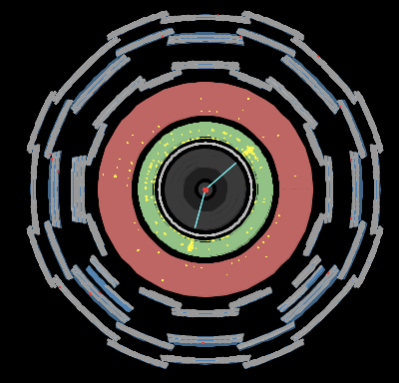
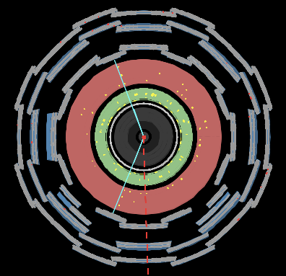
HYPATIA Event Display
How are these events similar? Different? Why?

Slide 17
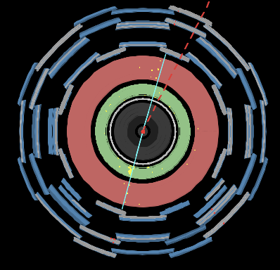
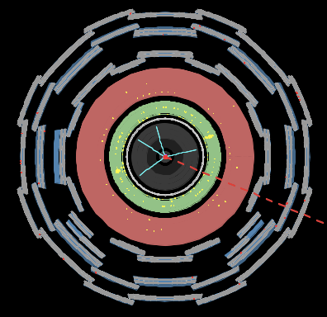
HYPATIA Event Display
How are these events similar? Different? Why?

Slide 18
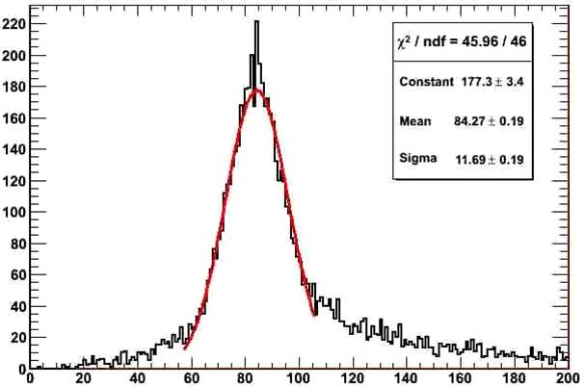
ATLAS Mass Plot
From: W Mass as a Calibration of the Jet Energy Scale in ATLAS (poster, 2008) Daniel Goldin, Southern Methodist University, for the ATLAS Collaborationhttp://cdsweb.cern.ch/record/1132028/files/ATL-SLIDE-2008-100.ppt

Slide 19
Keep in Mind . . .
“Science is nothing but developed perception, interpreted intent, common sense rounded out and minutely articulated.” George Santayana
Indirect observations and imaginative, critical, logical thinking can lead to reliable and valid inferences.
Therefore: work together, think (sometimes outside the box), and be critical of each other’s results to figure out what is happening.

Slide 20
Let’s Analyze Events!
Make teams of two.
Practice.
Talk with physicists.
Find good Z and H candidates…and more.
Which events will be included in the mass plot?
AND plot the mass!
Report! Rapport! Rejoice! Relax!

