Slide 1
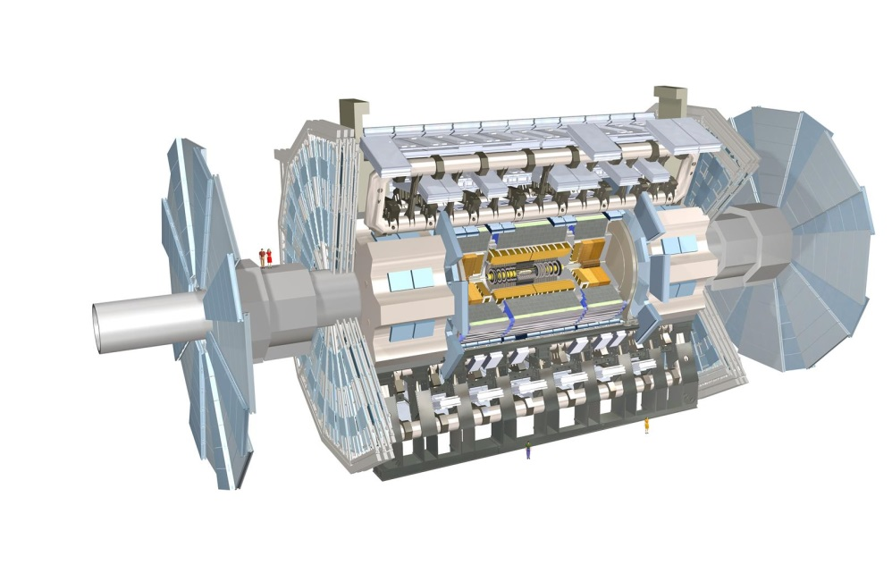
ATLAS Masterclass-in-a-box
Data File 3 (Events 81-120)

Slide 2
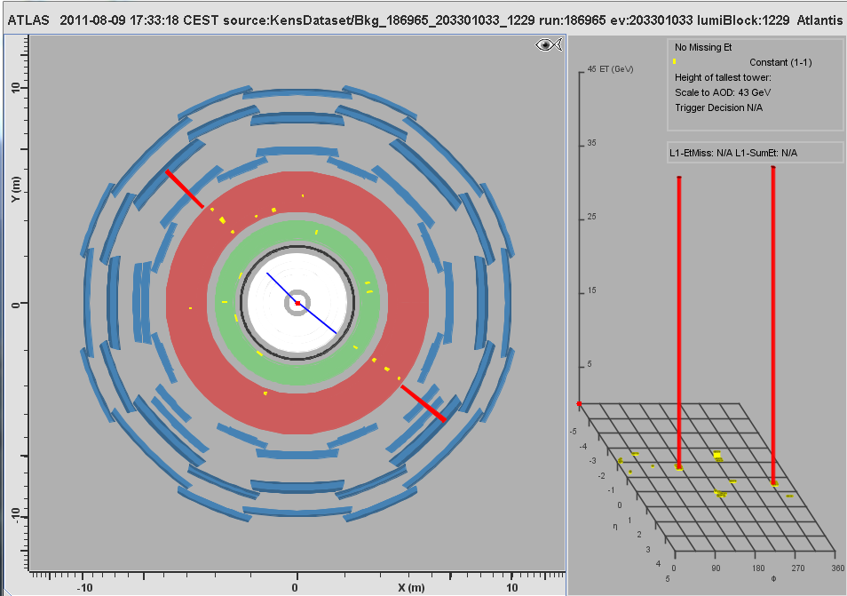
MC Event #081

Slide 3
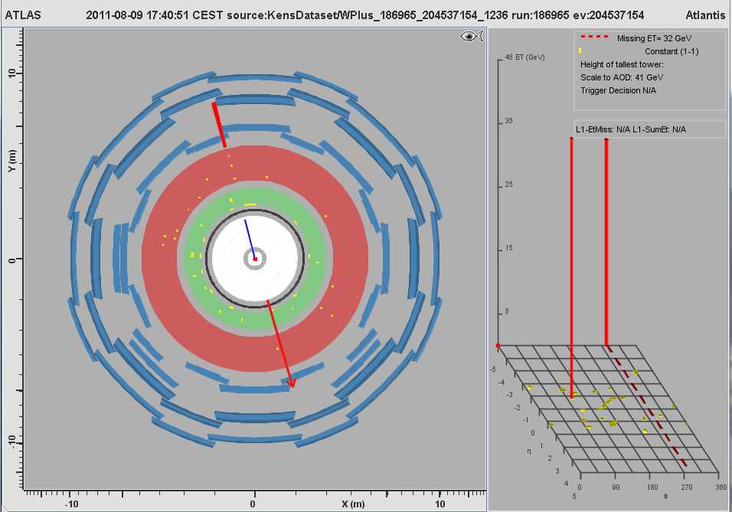
MC Event #082

Slide 4
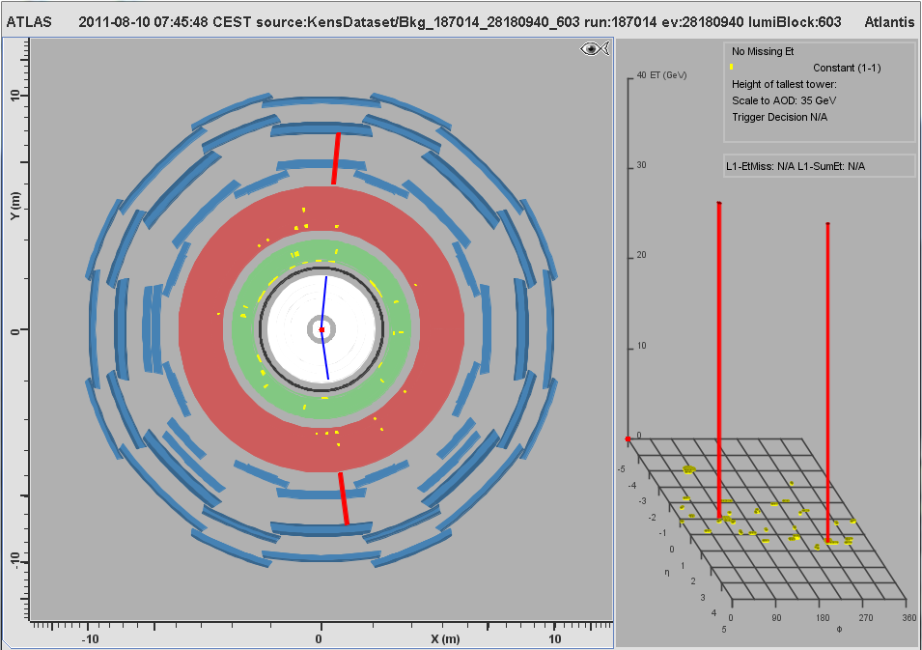
MC Event #083

Slide 5
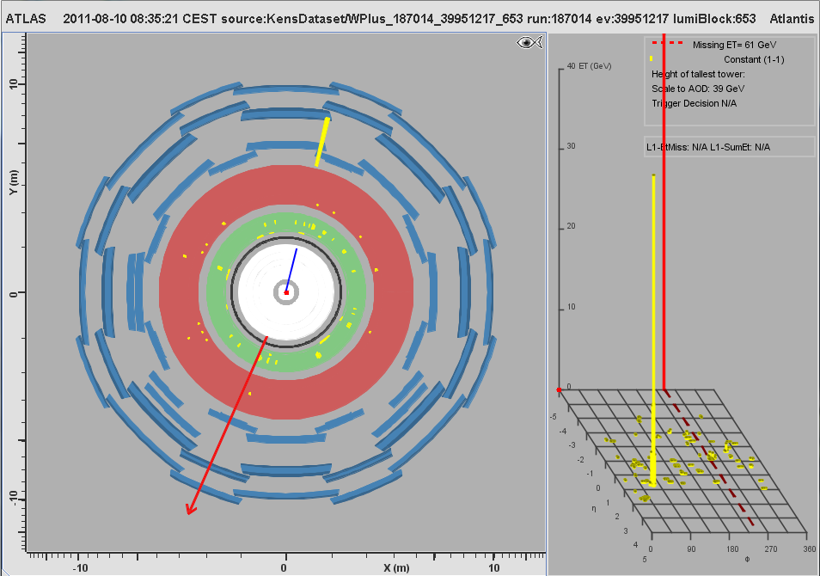
MC Event #084

Slide 6
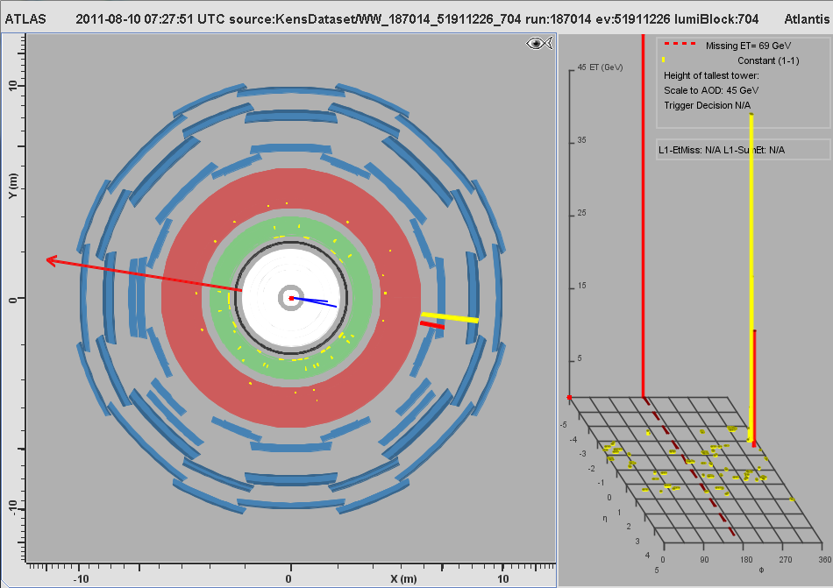
MC Event #085

Slide 7
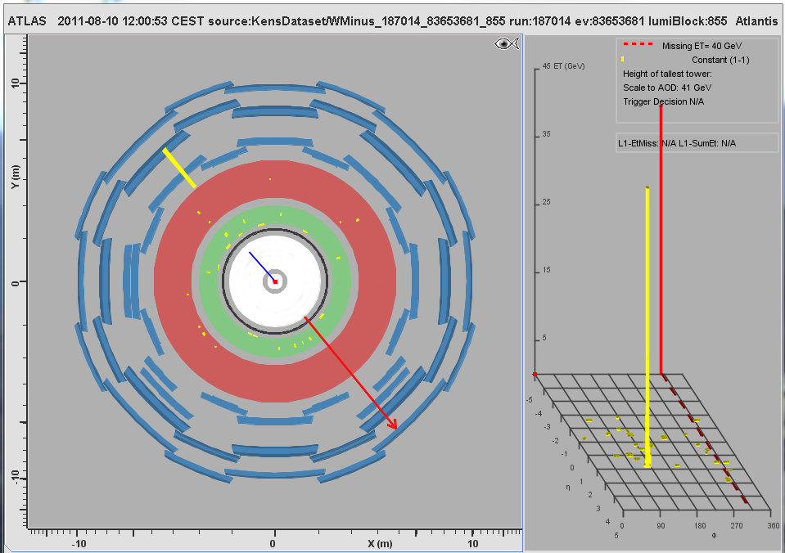
MC Event #086

Slide 8
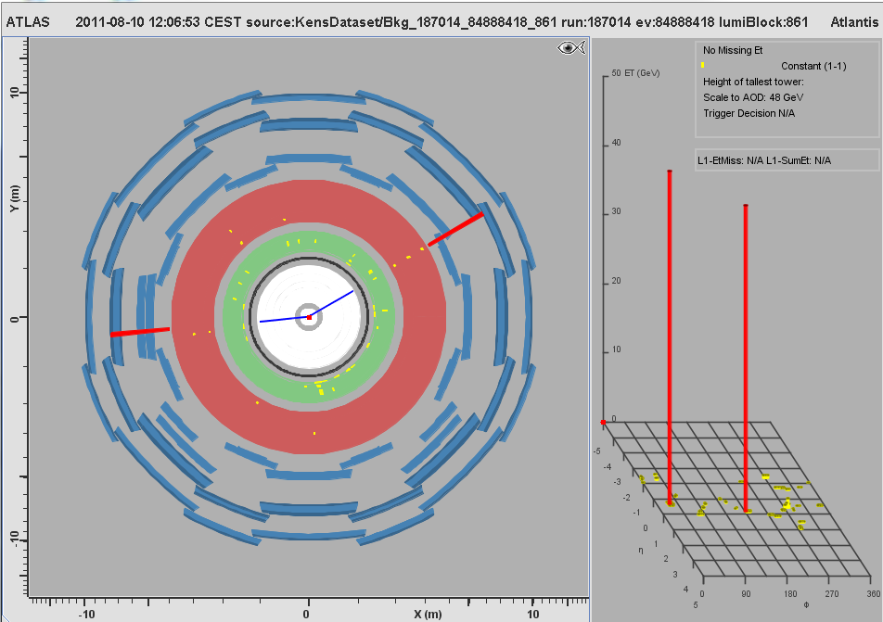
MC Event #087

Slide 9
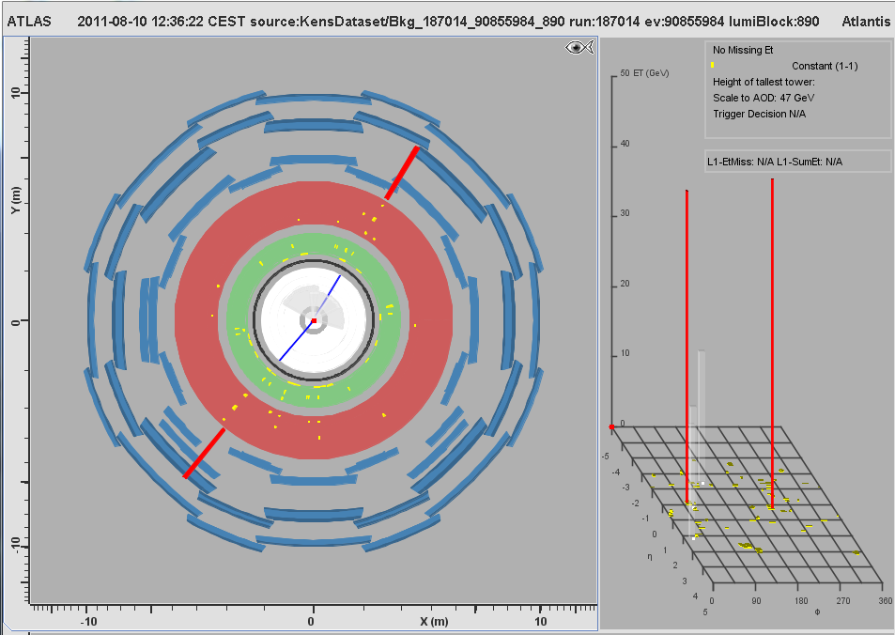
MC Event #088

Slide 10
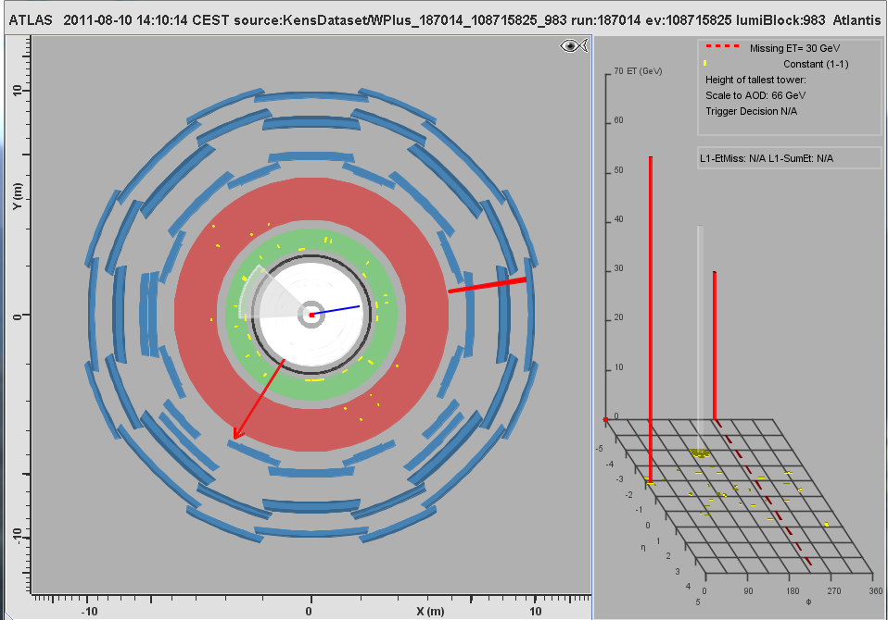
MC Event #089

Slide 11
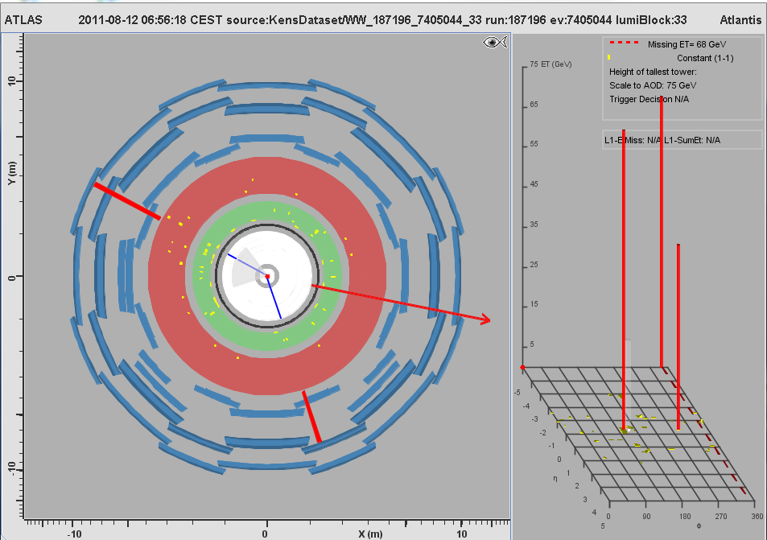
MC Event #090

Slide 12
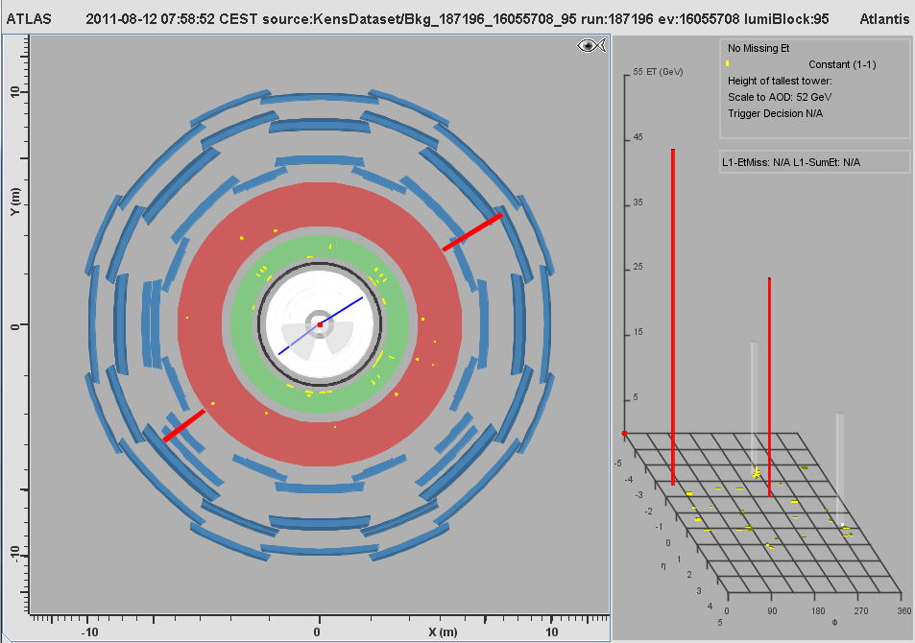
MC Event #091

Slide 13
MC Event #092

Slide 14
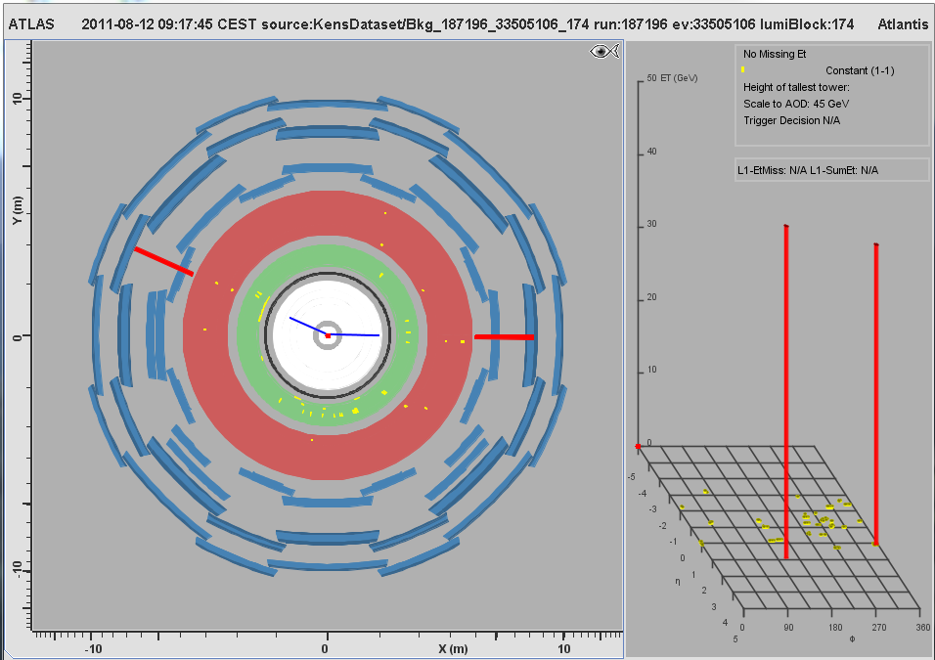
MC Event #093

Slide 15
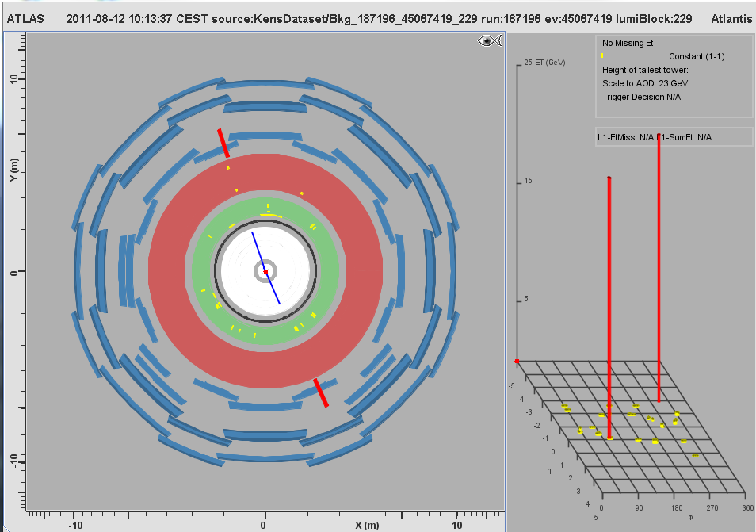
MC Event #094

Slide 16
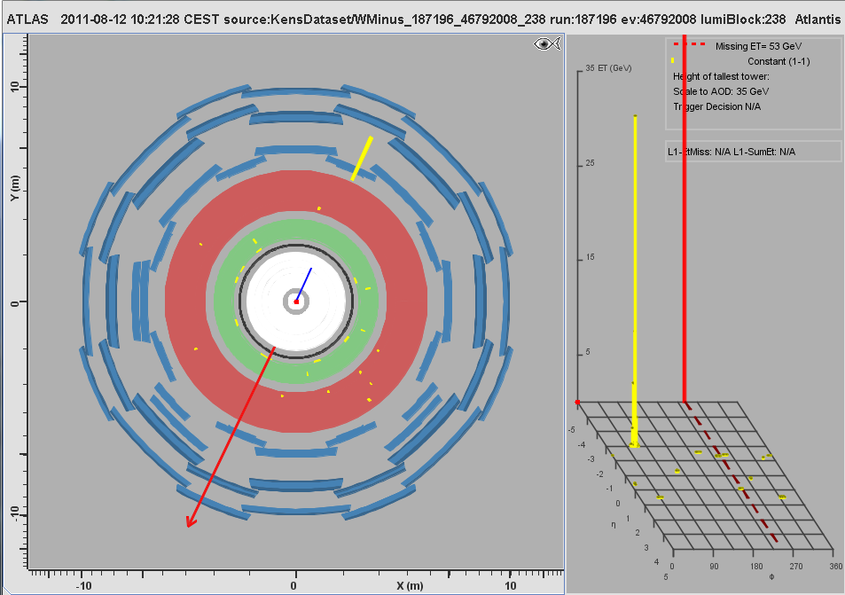
MC Event #095

Slide 17
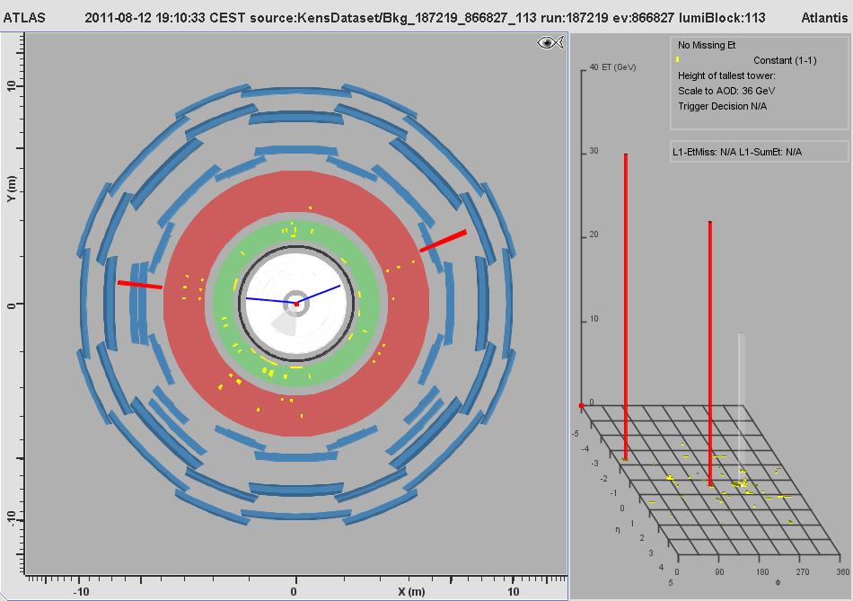
MC Event #096

Slide 18
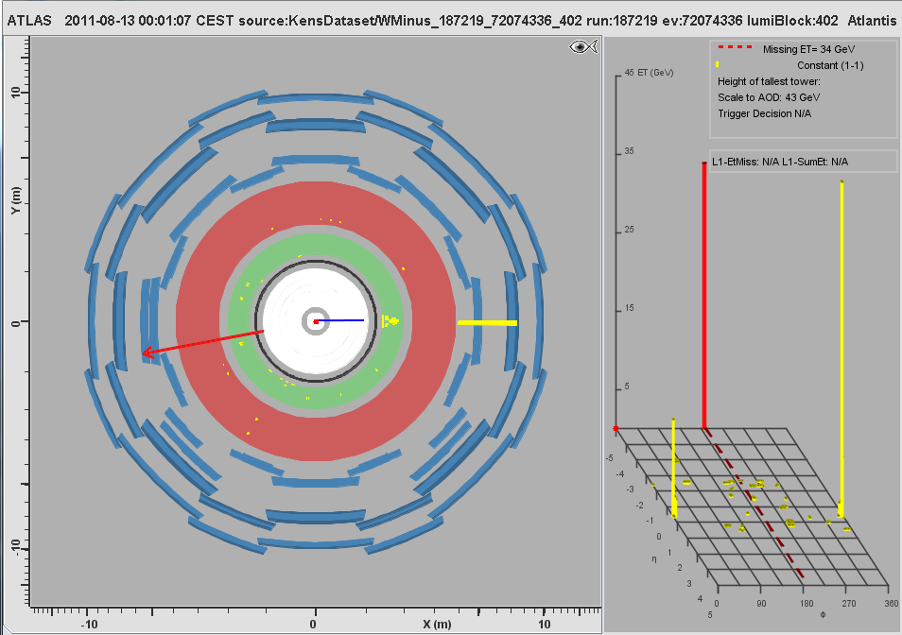
MC Event #097

Slide 19
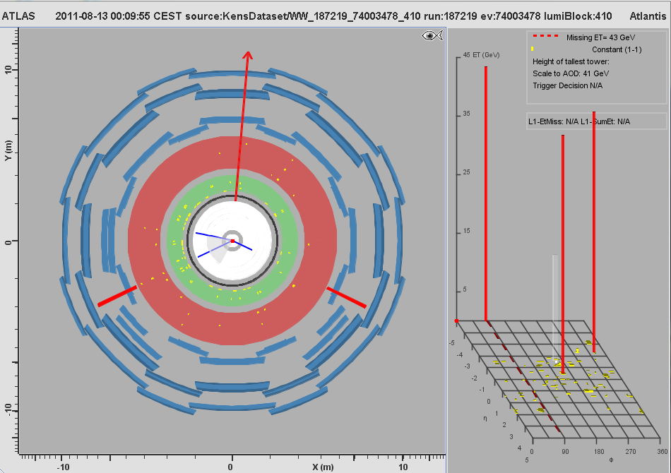
MC Event #098

Slide 20
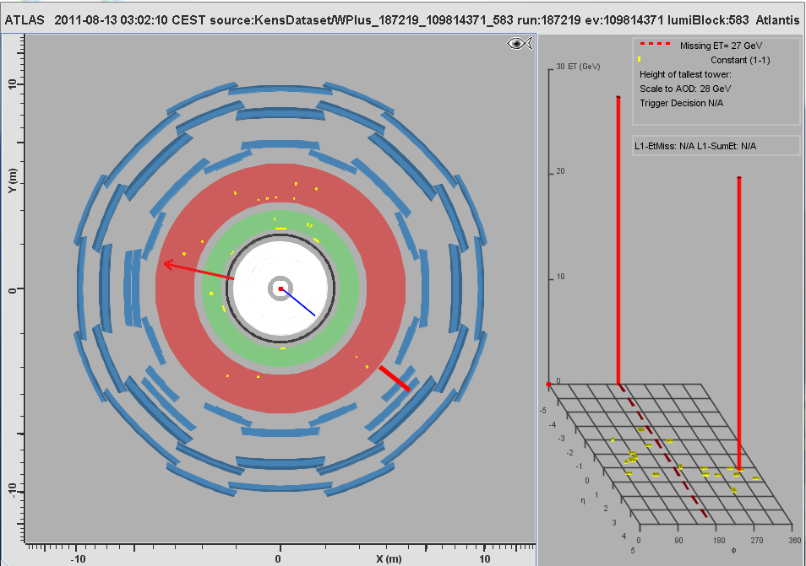
MC Event #099

Slide 21
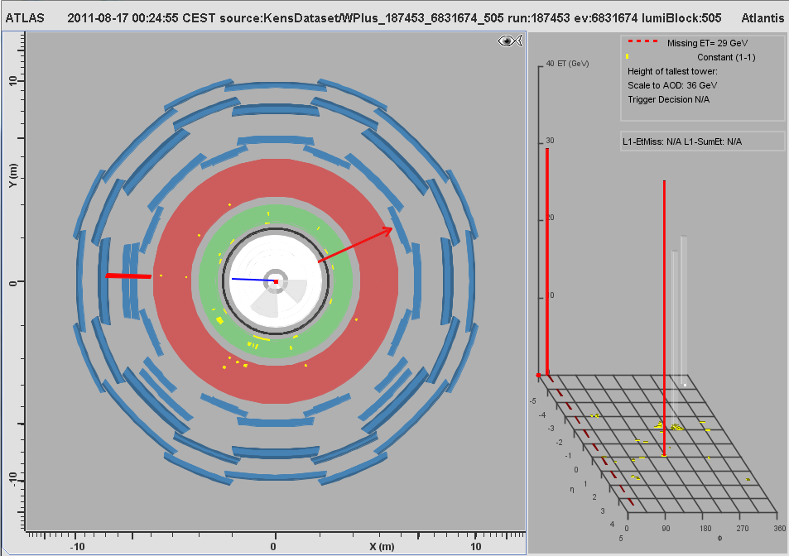
MC Event #100

Slide 22
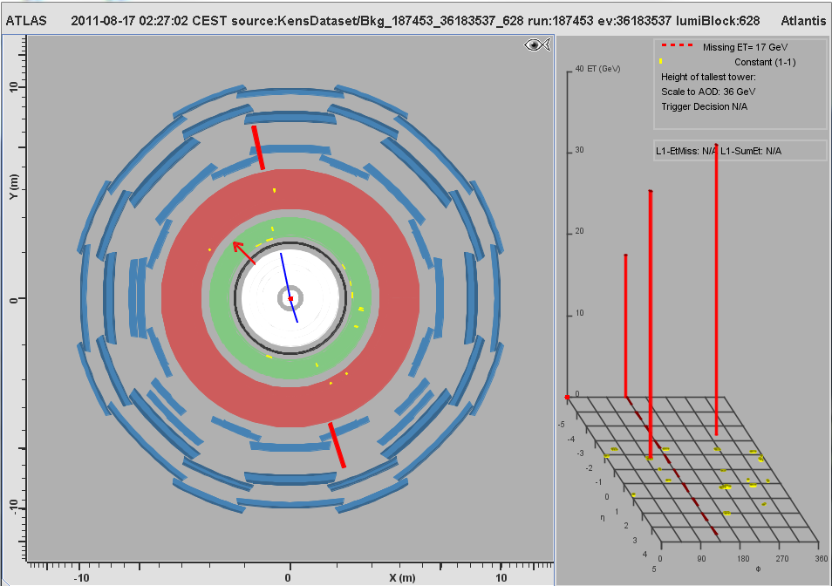
MC Event #101

Slide 23
MC Event #102

Slide 24
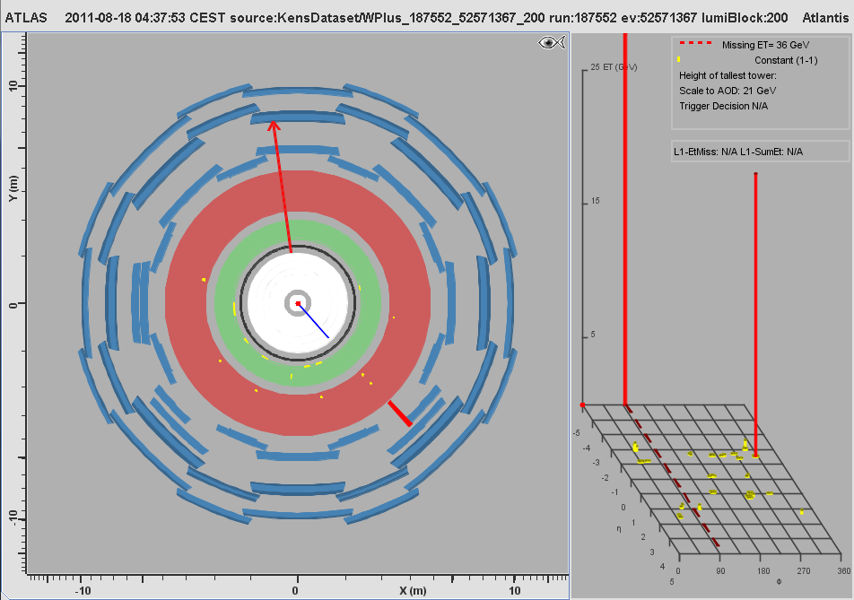
MC Event #103

Slide 25
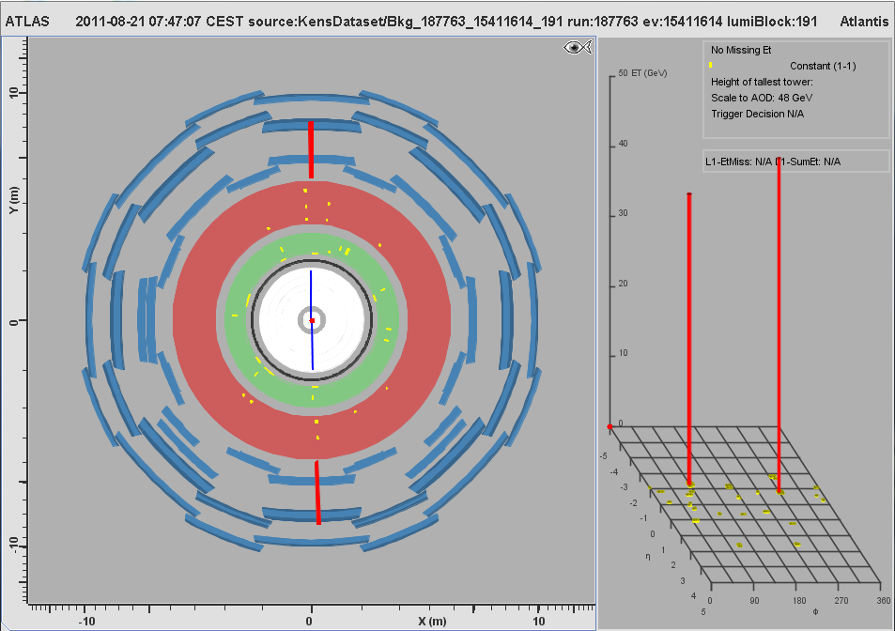
MC Event #104

Slide 26
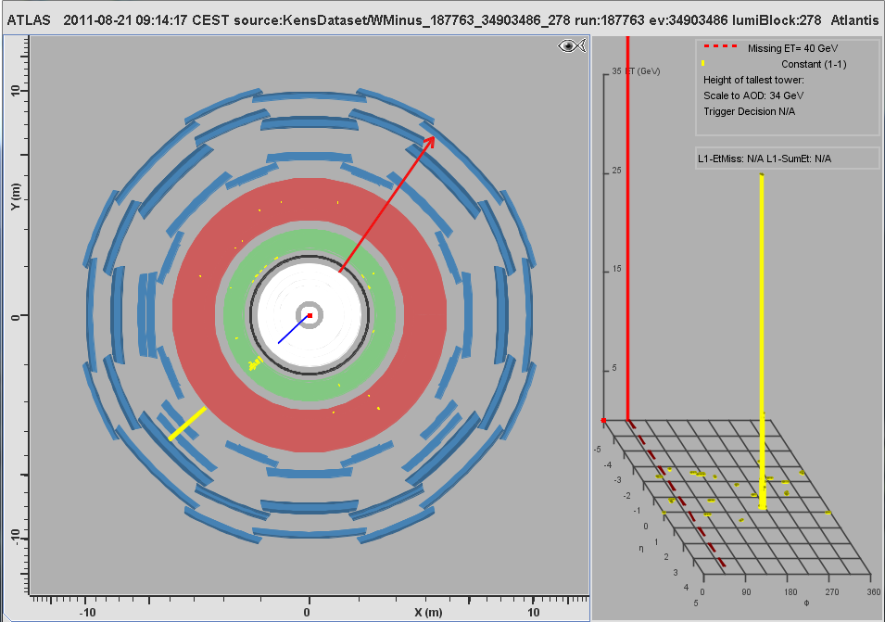
MC Event #105

Slide 27
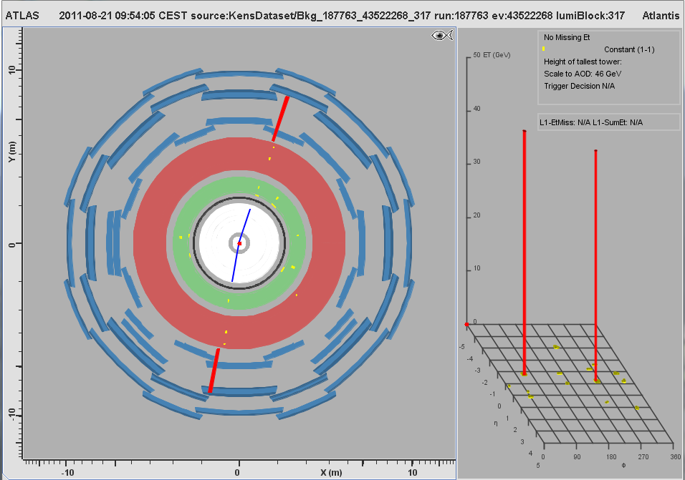
MC Event #106

Slide 28
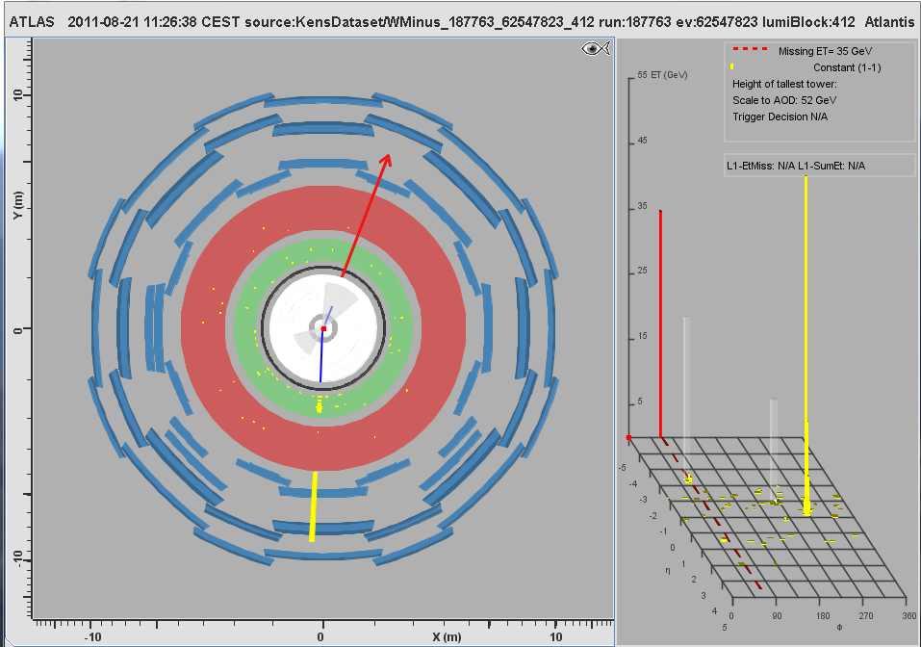
MC Event #107

Slide 29
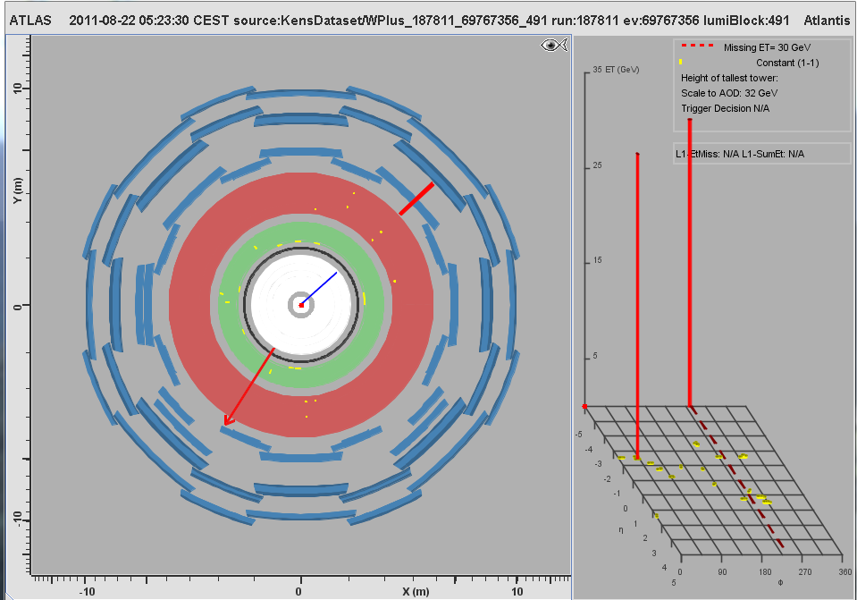
MC Event #108

Slide 30
MC Event #109

Slide 31
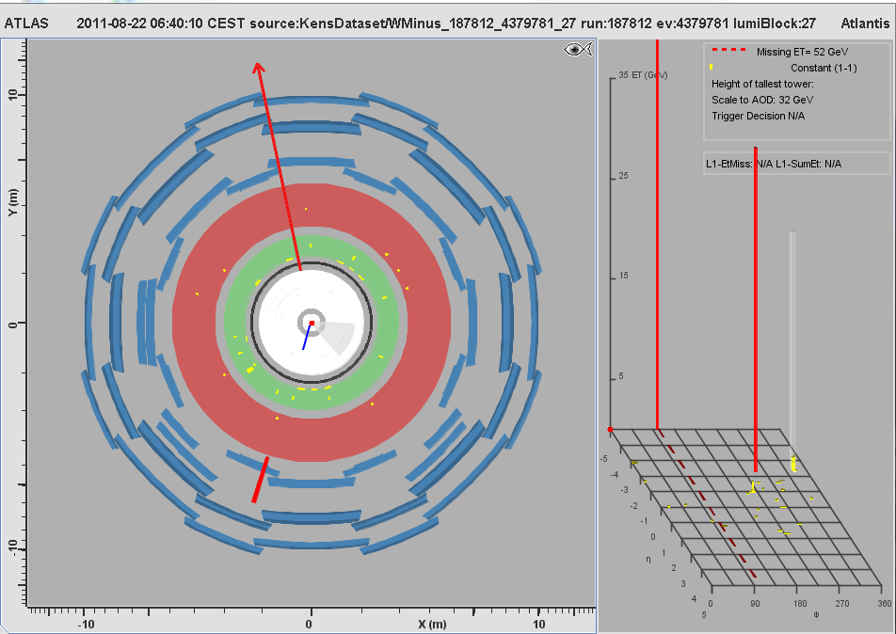
MC Event #110

Slide 32
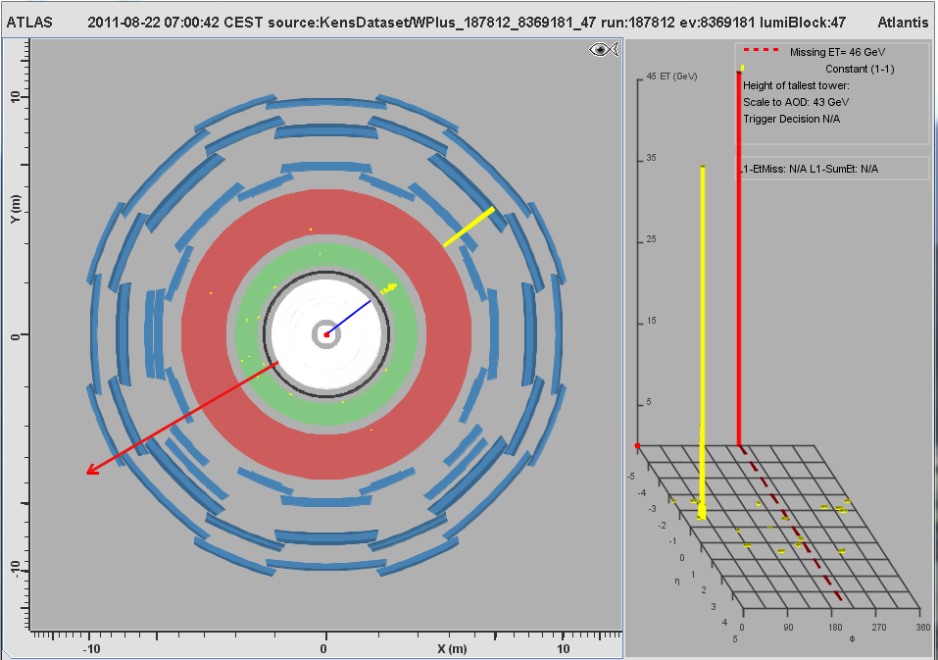
MC Event #111

Slide 33
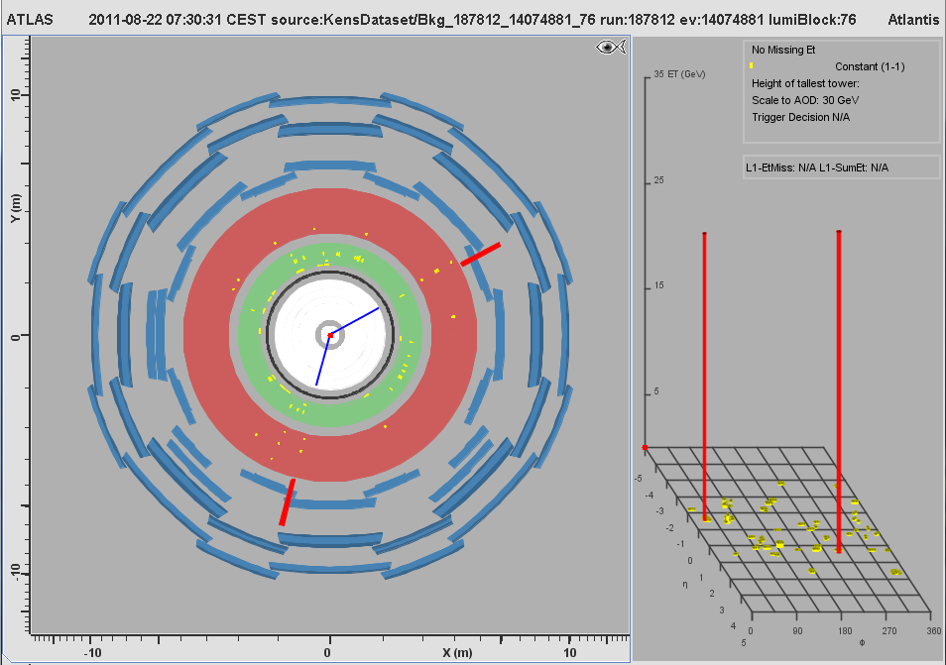
MC Event #112

Slide 34
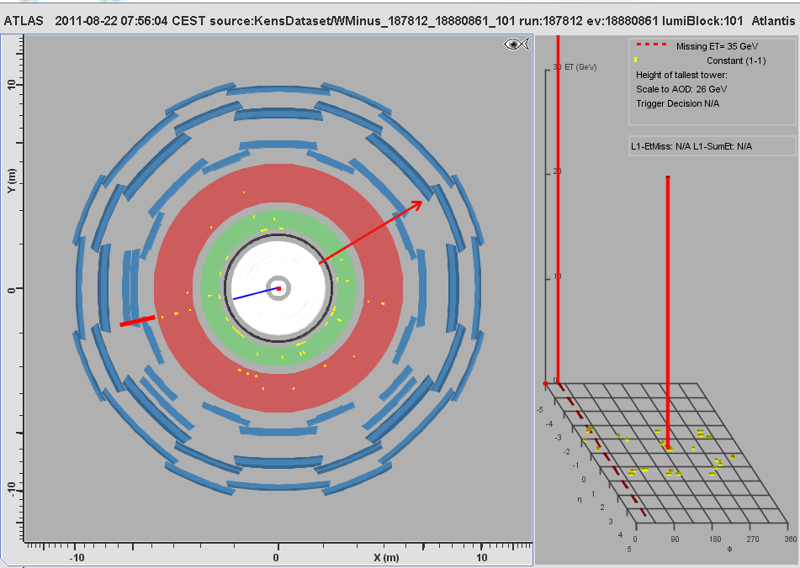
MC Event #113

Slide 35
MC Event #114

Slide 36
MC Event #115

Slide 37
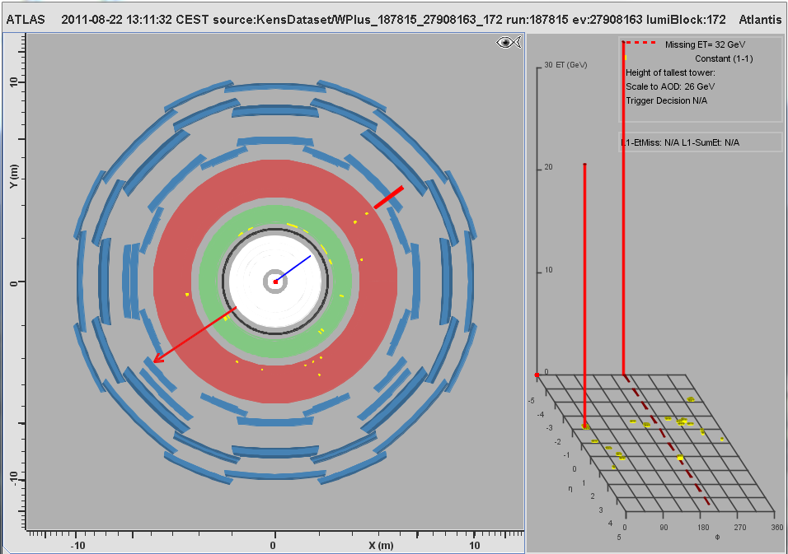
MC Event #116

Slide 38
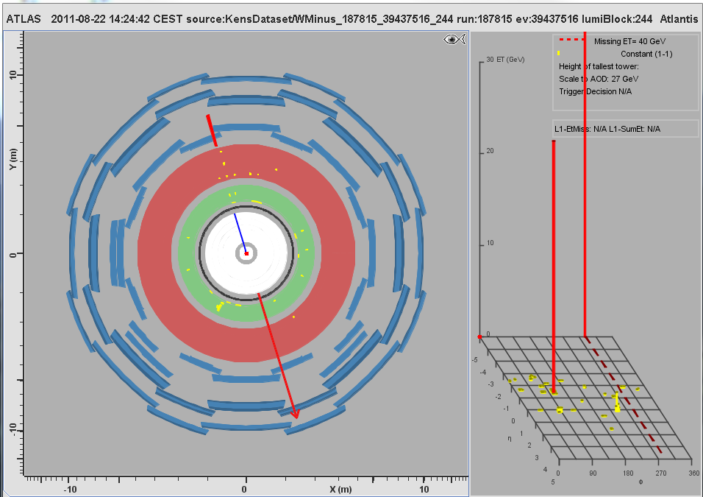
MC Event #117

Slide 39
MC Event #118

Slide 40
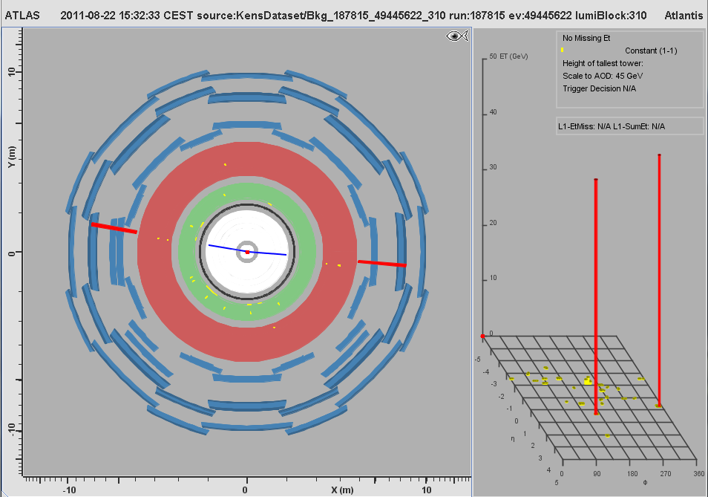
MC Event #119

Slide 41
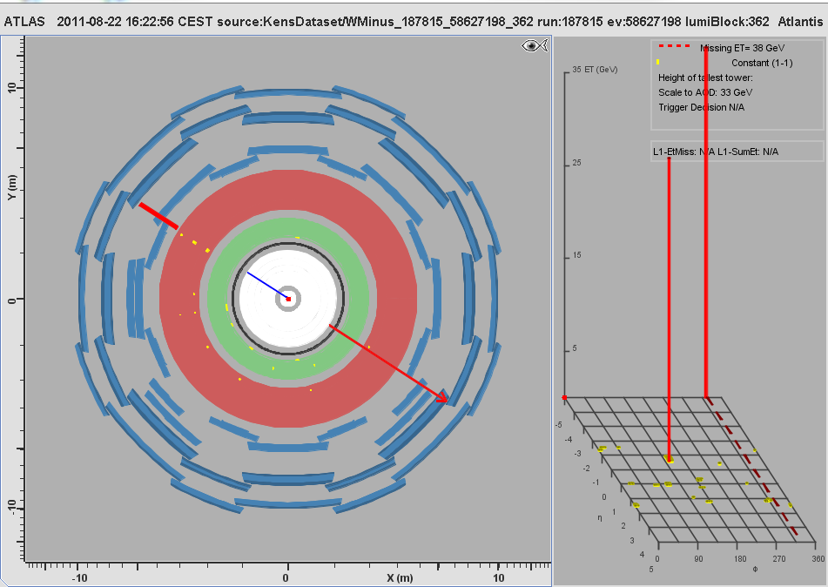
MC Event #120

