Slide 1
Heisenberg’s Laser
Events

Slide 2
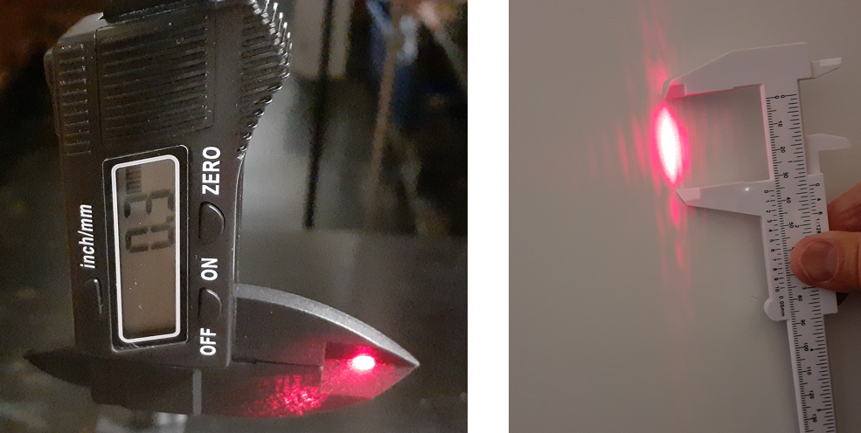
Event 1: Report Slit width and Central Max width

Slide 3
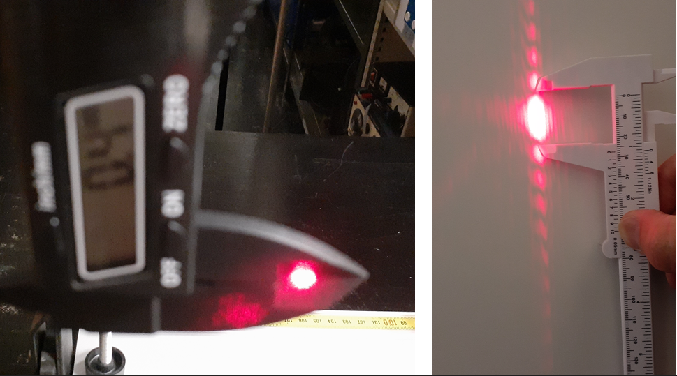
Event 2: Report Slit width and Central Max width

Slide 4
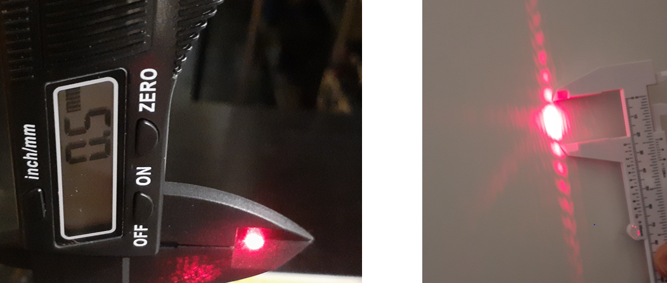
Event 3: Report Slit width and Central Max width

Slide 5
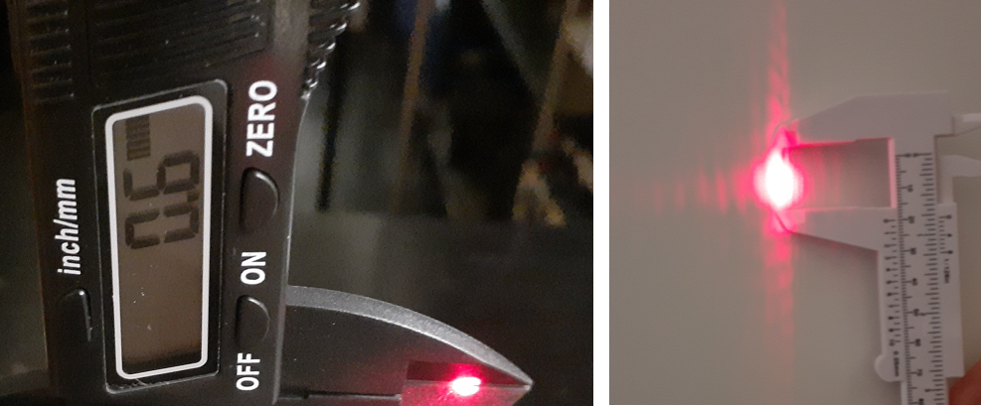
Event 4: Report Slit width and Central Max width

Slide 6
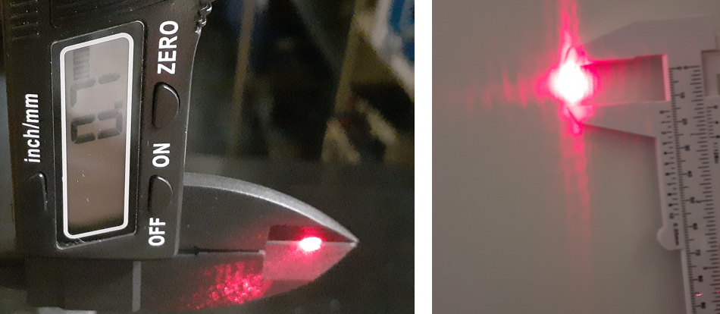
Event 5: Report Slit width and Central Max width

Slide 7
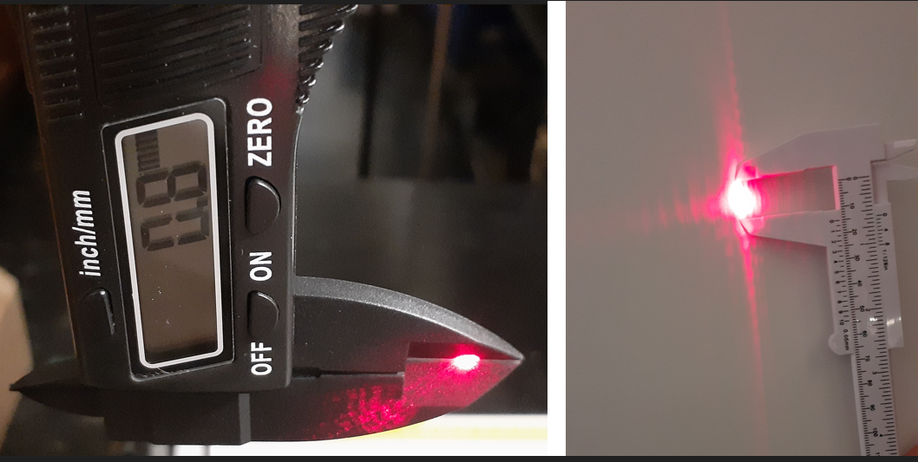
Event 6: Report Slit width and Central Max width

Slide 8
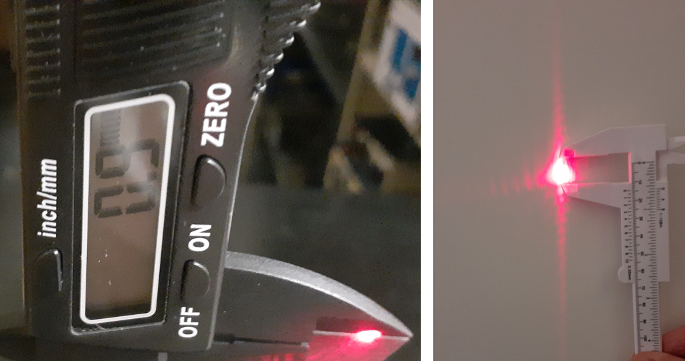
Event 7: Report Slit width and Central Max width

Slide 9
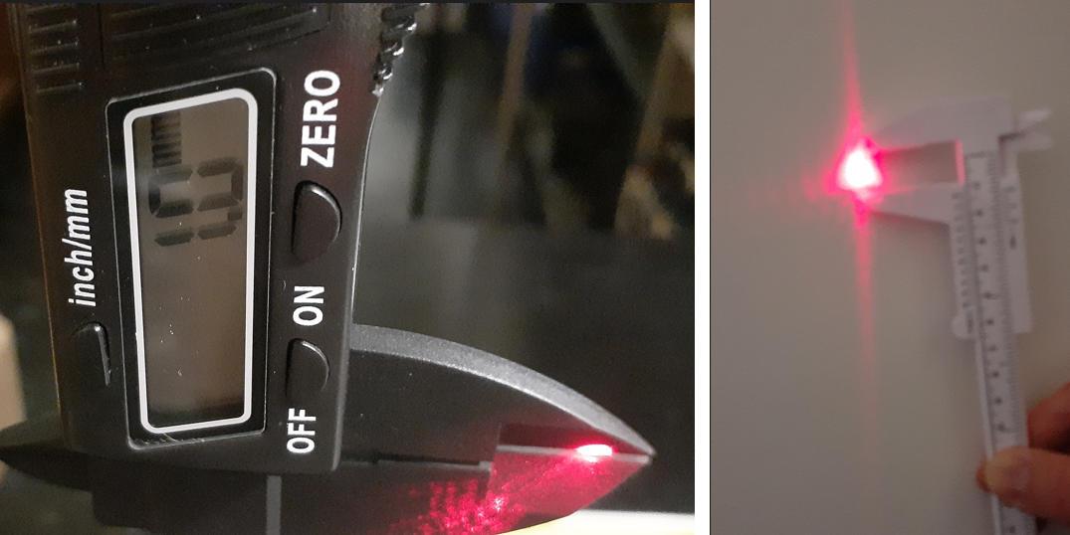
Event 8: Report Slit width and Central Max width

